Slide 1
Module 8: Cisco Platforms and Development
Instructor Materials
DevNet Associate v1.0 (DEVASC)
Notes:
Cisco Networking Academy Program
DevNet Associate (DEVASC) v1.0
Module 8: Cisco Platforms and Development

Slide 2
Instructor Materials – Module 8 Planning Guide
This PowerPoint deck is divided in two parts:
Instructor Planning Guide
Information to help you become familiar with the module
Teaching aids
Instructor Class Presentation
Optional slides that you can use in the classroom
Begins on slide # 10
Note: Remove the Planning Guide from this presentation before sharing with anyone.
For additional help and resources go to the Instructor Home Page and Course Resources for this course. You also can visit the professional development site on netacad.com, the official Cisco Networking Academy Facebook page, or Instructor Only FB group.
Notes:
2

Slide 3
What to Expect in this Module
To facilitate learning, the following features within the GUI may be included in this module:
Feature | Description
Hands-On Labs | Labs designed for working with physical equipment.
Videos | Expose learners to new skills and concepts.
PT Activity | Simulation and modeling activities designed to explore, acquire, reinforce, and expand skills.
Module Quizzes | Self-assessments that integrate concepts and skills learned throughout the series of topics presented in the module.
Module Summary | Briefly recaps module content.

Slide 4
Check Your Understanding
Check Your Understanding activities are designed to let students quickly determine if they understand the content and can proceed, or if they need to review.
Check Your Understanding activities do not affect student grades.
There are no separate slides for these activities in the PPT. They are listed in the notes area of the slide that appears before these activities.
Notes:
4

Slide 5
Module 8: Activities
What activities are associated with this module?
Page # | Activity Type | Activity Name | Optional?
8.3.5 | Lab | Explore YANG Models | Recommended
8.3.6 | Lab | Use NETCONF to Access an IOS XE Device | Recommended
8.3.7 | Lab | Use RESTCONF to Access an IOS XE Device | Recommended
8.4.6 | Video | Access Cisco DNA Center using REST APIs in Python | Recommended
8.4.11 | Video | Access a Cisco APIC Using REST APIs in Python | Recommended
8.4.14 | Video | Access Meraki Dashboard Using REST APIs in Python | Recommended
8.4.18 | Video | Access Cisco NSO Using REST APIs in Python | Recommended
8.4.20 | Video | Access Cisco SD-WAN Using REST APIs in Python | Recommended
8.6.7 | Lab | Construct a Python Script to Manage Webex Teams | Recommended
8.8.2 | Packet Tracer | Compare using CLI and an SDN Controller to Manage a Network | Recommended
8.8.3 | Packet Tracer | Implement REST APIs with an SDN Controller | Recommended
Notes:
5

Slide 6
Module 8: Best Practices
Prior to teaching Module 8, the instructor should:
Review the activities and assessments for this module.
Try to include as many questions as possible to keep students engaged during classroom presentation.
Topic 8.1
List the Cisco dev centers for different technology groups.
Topic 8.2
Introduce SDK with an example.
Notes:
6

Slide 7
Module 8: Best Practices
Topic 8.3
Introduce data model and explain how model-driven programmability inherits the power of models.
Explain YANG with the help of a real life example.
List the commonly used YANG terms.
After explaining the concepts of YANG, RESTCONF and NETCONF, ask the learners to identify the differences between the three.
Topic 8.4
Ask the class to mention the importance of network automation.
Explain how to access the Cisco DNA Center Using REST APIs in Python via a video.
Explain how to access a Cisco APIC Using REST APIs in Python via a video.
Discuss all Cisco Network Management platforms including architectures, APIs, examples, benefits, and so on.
Demonstrate a video of how to access meraki dashboard using REST APIs in Python.
Notes:
7

Slide 8
Module 8: Best Practices
Topic 8.5
Provide an overview of Cisco Unified Computing System (UCS).
Provide a live demo of Cisco UCS Manager documentation and explain simultaneously.
Login into the UCS Power tool and walk the learners through the tool by entering different queries and outputs.
Ask the learners to login at the site https://intersight.com and ask them to try to generate Intersight API keys.
Topic 8.6
Familiarize the learners with Cisco Unified Communications Manager (Unified CM).
Provide a short demo of the Webex teams application (if, available) and explain its features.
Walk the learners through Cisco Finesse by showing them a short demo video of the application and explain the features.
Ask the class what are the Cisco Webex devices they are aware of?
Notes:
8

Slide 9
Module 8: Best Practices
Topic 8.7
Briefly explain Cisco’s security platforms.
Provide different resources and links to students on Cisco Security Platforms. Divide them into different groups and assign each group with a security platform and tell them to brainstorm and create a PowerPoint presentation and present in class. They must include the following topics:
Introduction
Benefits and Purpose
Architecture
Integration
Capabilities
Notes:
9

Slide 10
Module 8: Cisco Platforms and Development
DevNet Associate v1.0
Notes:
Cisco Networking Academy Program
DevNet Associate v1.0
Module 8: The DevNet Developer Environment
In-Session Activities / Explanations:
Time: 5 min
Instructor Notes:
Welcome the audience in a warm and cordial manner. Ensure that everyone is set up with the required resources.
Introduce the topic and encourage learners to come up with a list of expectations from the session.
Collate the topics on the white board or desktop while using learner’s inputs to interpret them in words.
To build the context of the module, brief the learners about the different platforms cisco offers and the technologies used for development.
Read the objectives and briefly describe each.
Key Points: NA

Slide 11
Module Objectives
Module Title: Cisco Platforms and Development
Module Objective: Compare Cisco platforms used for collaboration, infrastructure management, and automation.
Topic Title | Topic Objective
Introduction to Cisco Platforms | Describe the Cisco API platform.
Cisco SDKs | Explain how Cisco SDKs assist in the development of applications.
Understanding Network Programmability and Device Models | Compare network programmability models.
Cisco Network Management | Compare Cisco network management platforms.
Cisco Compute Management | Describe Cisco compute management solutions.
Cisco Collaboration Platforms | Describe Cisco collaboration platforms.
Cisco Security Platforms | Describe Cisco security platforms.
Notes:
11
8 – Cisco Platforms and Development
8.0.2 – What Will I Learn to do in this Module?

Slide 12
8.1 Introduction to Cisco Platforms
Notes:
Source:
8 – Cisco Platforms and Development
8.1 – Introduction to Cisco Platforms
In-Session Activities / Explanations:
Time: 5 mins
Instructor Notes:
Provide an overview of Cisco Platforms.
Familiarize the learners with Dev Centers.
Key Points: Cisco Dev Centers, Cloud, Collaboration, Data center, Internet of Things(IoT) and edge computing, Networking, Security, Wireless and mobile, Application developers

Slide 13
Cisco Platforms and Development Understanding the Cisco API Platform
Exploring the categories of Cisco technology
DevNet creates Dev Centers for each technology group and these Dev Centers make it very convenient for grouping technologies together.
List of Cisco Dev Centers is given below:
Cloud
Collaboration
Data center
Internet of Things (IoT) and edge computing
Networking
Security
Wireless and mobile
Application developers
Notes:
8 – Cisco Platforms and Development
8.1 – Introduction to Cisco Platforms
8.1.1 – Understanding the Cisco API Platform

Slide 14
8.2 Cisco SDKs
Notes:
Source:
8 – Cisco Platforms and Development
8.2 – Cisco SDKs
In-Session Activities / Explanations:
Time: 5 mins
Instructor Notes:
Brief the learners on Software Development Kit (SDK).
List the SDKs running on Cisco platforms.
Key Points: SDK, Cisco SDKs

Slide 15
Cisco SDKs What is an SDK?
Software Development Kit (SDK) contains a set of software development tools integrated for developing applications for a specific device or system.
Most SDKs are a package, integrated with libraries, documents, code examples, and so on.
SDKs often help with pagination or rate limiting constraints on responses for a particular API.
Cisco SDKs
Cisco provides a wide range of SDKs on different Cisco platforms, such as:
Webex Teams Android SDK
Jabber Web SDK
Jabber Guest SDK for Web
Jabber Guest SDK for iOS
Jabber Guest SDK for Android
Cisco DNA Center Multivendor SDK
UCS Python SDK
Cisco APIC Python SDK (Cobra SDK)
Cisco IMC Python SDK
Cisco Instant Connect SDK
Webex Teams Python SDK
Notes:
8 - Cisco Platforms and Development
8.2 - Cisco SDKs
8.2.1 - What is an SDK?

Slide 16
8.3 Understanding Network Programmability and Device Models
Notes:
Source:
8 – Cisco Platforms and Development
8.3 – Understanding Network Programmability and Device Models
In-Session Activities / Explanations:
Time: 25 min
Instructor Notes:
Explain what is model-driven programmability
Define YANG
Define NETCONF
Differentiate between NETCONF and SNMP
Discuss RESTCONF
At the end of the topic, enquire how the learners have performed in the lab sessions.
Key Points: YANG, NETCONF, RESTCONF

Slide 17
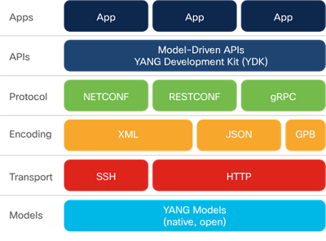
Understanding Network Programmability and Device Models What is Model-Driven Programmability?
Model-driven programmability:
Provides configuration language that is human-readable
Is Model-based, structured, and computer-friendly
Includes support for multiple model types, including native, OpenConfig, and IETF
Uses specification that is decoupled from transport, protocol end encoding.
Uses model-driven APIs for abstraction and simplification.
Leverages open-source and enjoys wide support.
Yang-based Model-driven Programmability Stack
Notes:
8 - Cisco Platforms and Development
8.3 - Understanding Network Programmability and Device Models
8.3.1 - What is Model-Driven Programmability?

Slide 18
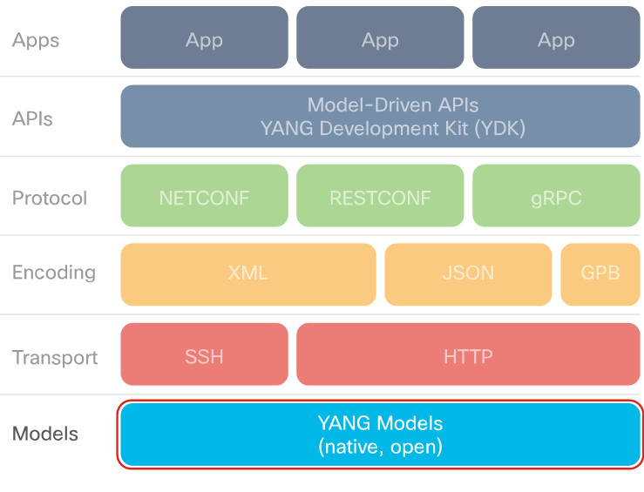
Understanding Network Programmability and Device Models What is YANG?
Yet Another Next Generation, (YANG) as defined in RFC7519, is “a data modeling language used to model configuration and state data manipulated by the Network Configuration Protocol (NETCONF), NETCONF remote procedure calls, and NETCONF notifications.”
In the real world, there are two types of YANG models, open and native.
YANG in the Model-Driven Programmability Stack
Notes:
8 - Cisco Platforms and Development
8.3 - Understanding Network Programmability and Device Models
8.3.2 - What is YANG?

Slide 19
Understanding Network Programmability and Device Models What is YANG? (Contd.)
Why we need YANG for device modeling?
YANG allows different network device vendors to describe their device type, configuration, and state to map to the device operation in programmatic way.
YANG defines four types of nodes for data modeling: Leaf Nodes, Leaf-List Nodes, Container Nodes, and List Nodes.
Yang Terms
anyxml. | data model | derived type | leaf | module
augment | data node | grouping | leaf-list | RPC
container | data tree | identifier | list | state data
Notes:
8 - Cisco Platforms and Development
8.3 - Understanding Network Programmability and Device Models
8.3.2 - What is YANG?

Slide 20
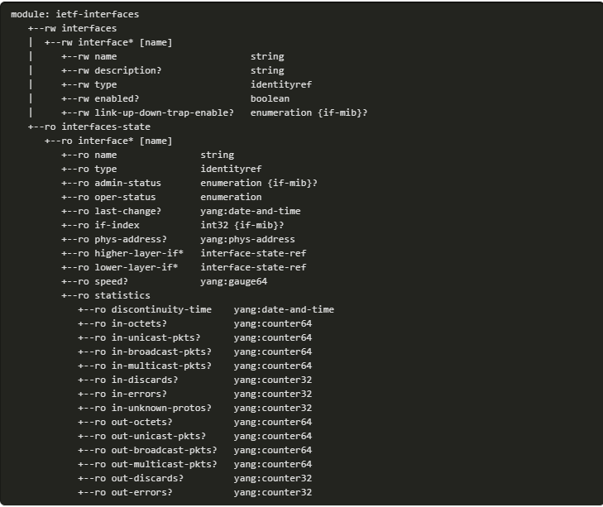
Understanding Network Programmability and Device Models What is YANG? (Contd.)
Yang in Action
As the content of the Yang file increases, pyang is one of the tools used to extract the content in a more readable and concise way.
You can install pyang using the pip command in a virtual environment.
Using the pyang tool, you can convert a YANG file into an easy-to-follow tree structure as shown in the Pyang output example.
Pyang Output Example
Notes:
8 - Cisco Platforms and Development
8.3 - Understanding Network Programmability and Device Models
8.3.2 - What is YANG?

Slide 21
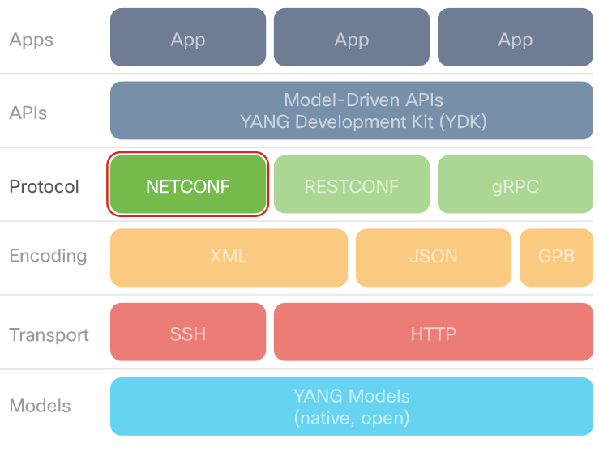
Understanding Network Programmability and Device Models What is NETCONF?
Network Configuration (NETCONF), a protocol defined by the IETF RFC7519, is designed to install, manipulate, and delete the configuration of network devices.
It is the primary protocol used with YANG data models today.
The NETCONF protocol uses XML-based data encoding for both the configuration data and the protocol messages.
It provides a small set of operations to manage device configurations and retrieve device state information.
NETCONF in the Model-Driven Programmability Stack
Notes:
8 - Cisco Platforms and Development
8.3 - Understanding Network Programmability and Device Models
8.3.3 - What is NETCONF?

Slide 22
Understanding Network Programmability and Device Models What is NETCONF? (Contd.)
NETCONF Protocol Operations
The NETCONF protocol provides a set of operations to manage device configurations and retrieve device state information. The base protocol includes the following operations:
NETCONF Protocol Operation
get | copy-config | unlock
get-config | delete-config | close-session
edit-config | lock | kill-session
Notes:
8 - Cisco Platforms and Development
8.3 - Understanding Network Programmability and Device Models
8.3.3 - What is NETCONF?

Slide 23
Understanding Network Programmability and Device Models What is NETCONF? (Contd.)
NETCONF versus SNMP
NETCONF and SNMP protocols are both defined to remotely configure devices.
Features of both are given below:
NETCONF | SNMP
Multiple configuration data stores (candidate, running, startup) Device-level and network-wide transactions Configuration testing and validation Extensible remote procedure calls Built-in capability exchange | Uses pull model when retrieving data from device Does not have a discovery process for finding Management Information Base (MIBs) supported by a device Does not support the concept of transactions Lacks backup-and-restore of element configuration Limited industry support for configuration MIBs
Notes:
8 - Cisco Platforms and Development
8.3 - Understanding Network Programmability and Device Models
8.3.3 - What is NETCONF?

Slide 24
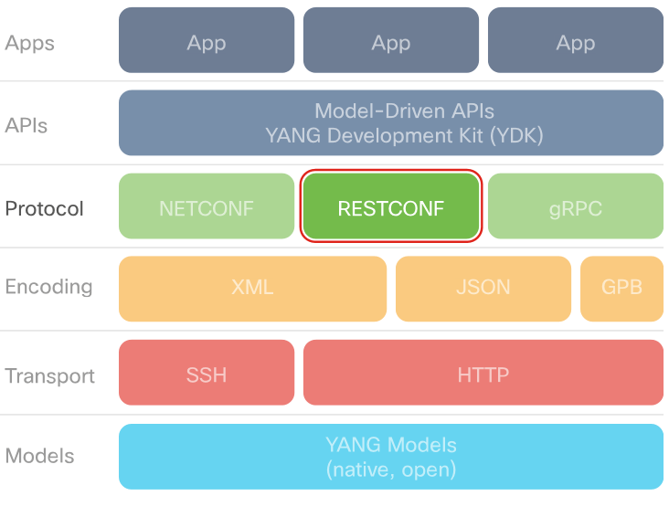
Understanding Network Programmability and Device Models What is RESTCONF?
The RESTCONF RFC 8040 defines a protocol and mechanism for REST-like access to configuration information and control.
RESTCONF uses datastore models and command verbs defined in NETCONF, encapsulated in HTTP messages.
RESTCONF uses structured data (XML or JSON) and YANG to provide REST-like APIs, enabling programmatic access to devices.
RESTCONF is not intended to replace NETCONF, instead provide an HTTP interface that follows the REST principles and is compatible with the NETCONF datastore model.
RESTCONF in the Model-Driven Programmability Stack
Notes:
8 - Cisco Platforms and Development
8.3 - Understanding Network Programmability and Device Models
8.3.4 - What is RESTCONF?

Slide 25
Understanding Network Programmability and Device Models What is RESTCONF? (Contd.)
RESTCONF vs. NETCONF
Overall, NETCONF is more comprehensive, flexible, and complex than RESTCONF. The differences between NETCONF and RESTCONF:
RESTCONF is easier to learn and use for engineers with previous REST API experience.
NETCONF supports running and candidate data stores, while RESTCONF supports only a running data store as any edits of candidate data store are immediately committed.
RESTCONF does not support obtaining or releasing a data store lock. If a data store has an active lock, the RESTCONF edit operation will fail.
A RESTCONF edit is a transaction limited to a single RESTCONF call.
RESTCONF does not support transactions across multiple devices.
Validation is implicit in every RESTCONF editing operation, which either succeeds or fails.
Notes:
8 - Cisco Platforms and Development
8.3 - Understanding Network Programmability and Device Models
8.3.4 - What is RESTCONF?

Slide 26
Understanding Network Programmability and Device Models What is RESTCONF? (Contd.)
NETCONF operations and RESTCONF methods mapping
Description | NETCONF | RESTCONF
Create a data resource | <edit-config>, </edit-config> | POST
Retrieve data and metadata | <get-config>, <get> , </get-config> | GET
Create or replace a data resource | <edit-config> (nc:operation="create/replace") | PUT
Delete a data resource | <edit-config> (nc:operation="delete") | DELETE
The RESTCONF RFC 8040 states that RESTCONF base URI syntax is /restconf/<resource-type>/<yang-module:resource>. <resource-type> and <yang-module:resource> are variables and the values are obtained using specific YANG model files.
The basic format of a RESTCONF URL is https://<hostURL>/restconf<resource><container><leaf><options> where any portion after restconf could be omitted.
Note: You will learn to use RESTCONF in the lab and also use it to access an IOS XE Device.
Notes:
8 - Cisco Platforms and Development
8.3 - Understanding Network Programmability and Device Models
8.3.4 - What is RESTCONF?

Slide 27
Understanding Network Programmability and Device Models Lab – Explore YANG Models
In this lab, you will complete the following objectives:
Part 1: Launch the DEVASC VM and CSR1000v VMs
Part 2: Explore a YANG Model on GitHub
Part 3: Explore a YANG Model Using pyang
Notes:
8 – Cisco Platforms and Development
8.3 - Understanding Network Programmability and Device Models
8.3.5 - Lab - Explore YANG Models

Slide 28
Understanding Network Programmability and Device Models Lab – Use NETCONF to Access an IOS XE Device
In this lab, you will complete the following objectives:
Part 1: Build the Network and Verify Connectivity
Part 2: Use a NETCONF Session to Gather Information
Part 3: Use ncclient to Connect to NETCONF
Part 4: Use ncclient to Retrieve the Configuration
Part 5: Use ncclient to Configure a Device
Part 6: Challenge: Modify the Program Used in This Lab
Notes:
8 – Cisco Platforms and Development
8.3 - Understanding Network Programmability and Device Models
8.3.6 - Lab - Use NETCONF to Access an IOS XE Device

Slide 29
Understanding Network Programmability and Device Models Lab – Use RESTCONF to Access an IOS XE Device
In this lab, you will complete the following objectives:
Part 1: Build the Network and Verify Connectivity
Part 2: Configure an IOS XE Device for RESTCONF Access
Part 3: Open and Configure Postman
Part 4: Use Postman to Send GET Requests
Part 5: Use Postman to Send a PUT Request
Part 6: Use a Python Script to Send GET Requests
Part 7: Use a Python Script to Send a PUT Request
Notes:
8 – Cisco Platforms and Development
8.3 - Understanding Network Programmability and Device Models
8.3.7 - Lab - Use NETCONF to Access an IOS XE Device

Slide 30
8.4 Cisco Network Management
Notes:
Source:
8 – Cisco Platforms and Development
8.4 - Cisco Network Management
In-Session Activities / Explanations:
Time: 45 mins
Instructor Notes:
Introduce the topic ‘Cisco Network Management’.
Describe network automation.
Discuss the different Network Management Platforms offered by Cisco.
Key Points: Network Management Platforms, Cisco IOS XE, Cisco SD-WAN, Cisco NSO, Cisco NX-OS Platform, Cisco ACI Cobra, Cisco DNA Center, Cisco Meraki, Cisco NSO Services

Slide 31
Cisco Network Management Network Management Platforms
Network automation plays a crucial part in simplifying day-to-day operations and maintenance.
Network automation is used for various common tasks in an organization:
Device Provisioning
Device software Management
Compliance Checks
Reporting
Troubleshooting
Data collection and telemetry
Network programmability helps reduce Operational Expenses (OPEX), which represents a significant portion of overall network cost.
Teams can speed up service delivery by automating tasks that are typically done by hand using a Command-Line Interface (CLI).
Notes:
8 – Cisco Platforms and Development
8.4 - Cisco Network Management
8.4.1 - Network Management Platforms

Slide 32
Cisco Network Management Cisco IOS XE
What is Cisco IOS XE?
With IOS XE, you have access to standards-based, consistent, programmable interfaces, standard data models for configuration, deployment, and rollback, as well as services integration with the network.
IOS XE is based on Linux.
Model-driven programmability support in Cisco IOS XE
Cisco device YANG models can be obtained from the Cisco Device YANG models repository.
IOS XE is used on most high-end Cisco platforms including switches, routers and gateways.
NETCONF/YANG is supported as of IOS XE 16.3.1 software.
Notes:
8 – Cisco Platforms and Development
8.4 - Cisco Network Management
8.4.2 - Cisco IOS XE

Slide 33
Cisco Network Management Cisco IOS XE (Contd.)
Enabling model-driven programmability
On some devices, Model-driven programmability services must first be enabled.
Enter the configuration mode using the configure terminal command.
Enable NETCONF on IOS XE
NETCONF connections should be authenticated using AAA credentials.
The CLI command to enable NETCONF is: netconf-yang
Troubleshooting:
If there is an ‘Unknown command’ response to the netconf-yang, as shown below, then double-check the device configuration.
Cisco IOS XE supports two datastores: running and candidate. It also supports locking datastores, as well as configuration rollback.
Notes:
8 – Cisco Platforms and Development
8.4 - Cisco Network Management
8.4.2 - Cisco IOS XE

Slide 34
Cisco Network Management Cisco IOS XE (Contd.)
Enable RESTCONF on IOS XE
RESTCONF connections should be authenticated using AAA credentials.
RESTCONF runs over HTTPS.
The command enabled to support RESTCONF over port 443 is: ip http secure-server
The CLI command to enable RESTCONF is: restconf
Accessing YANG models
For a complete look at Cisco YANG models, browse or clone the GitHub repository at https://github.com/YangModels/yang.
The vendor/cisco subdirectory contains models for Cisco platforms.
Notes:
8 – Cisco Platforms and Development
8.4 - Cisco Network Management
8.4.2 - Cisco IOS XE

Slide 35
Cisco Network Management Cisco DNA Center
What is Cisco DNA Center?
A Cisco DNA Center is a foundational controller and analytics platform for large and midsize organizations
It supports full 360-degree services and integration: North, East, Southbound and Westbound
Cisco DNA Center dashboard (GUI): The GUI organizes services and activities into Design, Policy, Provision, Assurance, and Platform.
Role-Based Access Control (RBAC): The initial user, ‘admin’, is assigned the SUPER-ADMIN-ROLE allowing complete control of the DNA Center and access to all sections.
Product hardware: The Cisco DNA Center appliance runs on dedicated Cisco Rack Servers in various scalable configurations.
Cisco DNA Center Intent API: The Intent API provides the means to programmatically access the Cisco DNA Center services and functionality.
Notes:
8 – Cisco Platforms and Development
8.4 - Cisco Network Management
8.4.3 - Cisco DNA Center

Slide 36
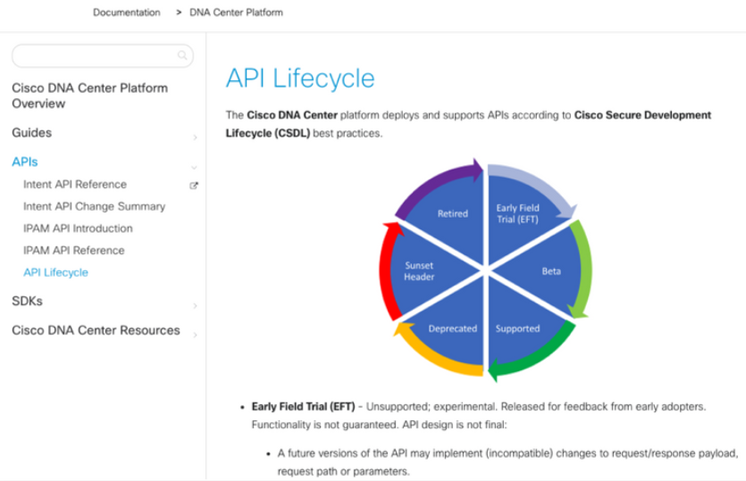
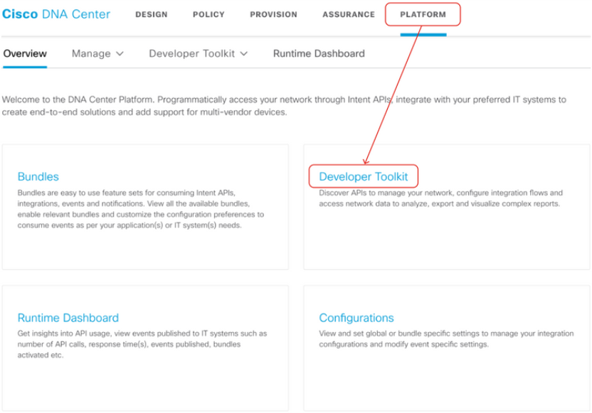
Cisco Network Management Cisco DNA Center – Intent API (Contd.)
Intent API documentation:
The Intent API documentation is found in the DevNet Cisco DNA Center, under section "Cisco DNA Center - Intent API."
Additional documentation and a built-in 'TryIt' capability is available in the product GUI, under Platform › Developer Toolkit.
API documentation on DevNet
API documentation via Developer Toolkit
Notes:
8 – Cisco Platforms and Development
8.4 - Cisco Network Management
8.4.4 - Cisco DNA Center - Intent API

Slide 37
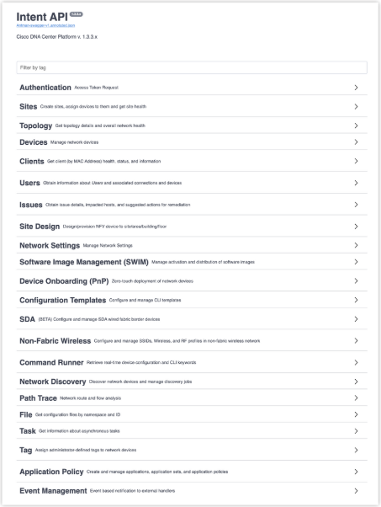
Cisco Network Management Cisco DNA Center – Intent API (Contd.)
Method description, URI, and Parameters
The DevNet documentation is organized by subdomain groups. The method URI is given in an abbreviated format, showing only the URL suffix.
The GUI Platform Developer Toolkit is organized by Domain: Subdomain. It includes specific expanded URL using the IP address of the DNA Center.
Clicking any subdomain name displays list of methods associated with that subdomain.
DevNet Intent API Subdomain
Notes:
8 – Cisco Platforms and Development
8.4 – Cisco Network Management
8.4.4 – Cisco DNA Center - Intent API

Slide 38
Cisco Network Management Cisco DNA Center – Create (POST) - Update (PUT)
Intent API PUT and POST methods require a JSON request payload.
Both POST and PUT requests are handled within the Cisco DNA Center asynchronously, which means that the request to add, create, or modify a resource is initiated with a correctly formed request, but not necessarily completed before responding.
A request, which has been successfully initiated, responds with a structure containing executionId, executionStatusUrl, and a status message.
Notes:
8 – Cisco Platforms and Development
8.4 - Cisco Network Management
8.4.5 - Cisco DNA Center – Create (POST) - Update (PUT)

Slide 39
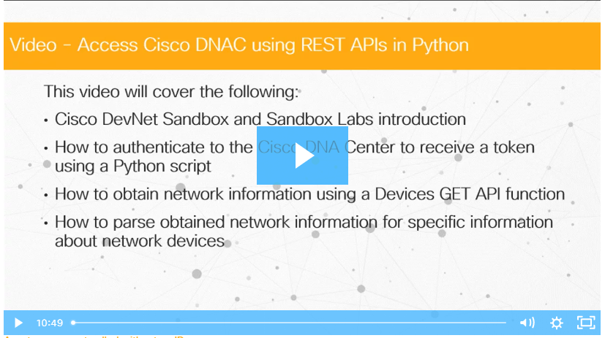
Cisco Network Management Video – Access Cisco DNA Center Using REST APIs in Python
Watch the video to learn how to access the Cisco DNA Center Using REST APIs in Python.
Notes:
8 – Cisco Platforms and Development
8.4 - Cisco Network Management
8.4.6 - Video – Access Cisco DNA Center Using REST APIs in Python

Slide 40
Cisco Network Management Cisco ACI
The Cisco Application Centric Infrastructure (ACI) platform that runs on Nexus 9000 hardware is the Cisco solution for Software-Defined Networking (SDN).
The centralized management system is the Application Policy Infrastructure Controller (APIC), a cluster of controllers. With APIC, you get a unified operation of both physical and virtual, or software-based infrastructure.
Instead of opening a subset of the network functionality through programmatic interfaces, the entire ACI infrastructure is opened up for programmatic access. This entirety is achieved by providing access to Cisco ACI object model.
The ACI object model represents the complete configuration and run-time state of every software and hardware component in the entire infrastructure.
Note: Rather than ACI mode, Nexus 9000 switches may be configured in NX-OS mode to access device-level APIs. In NX-OS mode you can manage switches as a Linux device.
Notes:
8 – Cisco Platforms and Development
8.4 - Cisco Network Management
8.4.7- Cisco ACI

Slide 41
Cisco Network Management Cisco ACI (Contd.)
ACI use cases
Common use cases include:
Programmability as a single fabric, with access to read and write object models representing all attributes in the system.
Desired state defined and enforced.
Extension to AWS or Azure public clouds (via Multi-Site Orchestrator (MSO) and its API)
Tools used with ACI
ACI toolkit, Cobra (Python), ACIrb (Ruby), Puppet, and Ansible
Note: The above tools are available for accessing the Multi-Site Orchestrator (MSO) for hybrid clouds as well. MSO's API is different from ACI's, the latter is used to access a private ACI fabric via its Application Policy Interface Controller (APIC).
Notes:
8 – Cisco Platforms and Development
8.4 - Cisco Network Management
8.4.7- Cisco ACI
Instructor Notes:
Visit the website for Cobra installation Documentation

Slide 42
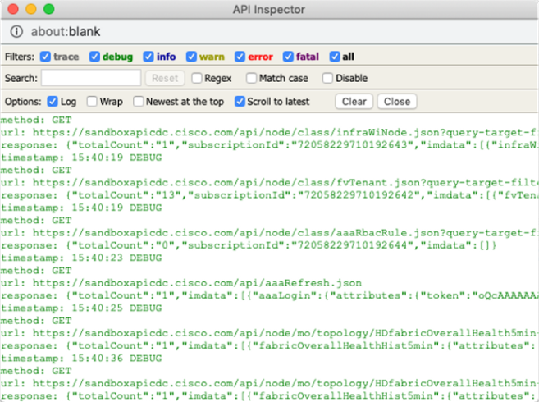
Cisco Network Management Cisco ACI (Contd.)
API Inspector
When a task is performed in the Cisco APIC GUI, the GUI creates and sends internal API messages to the operating system to execute the task.
By using the API Inspector, which is a built-in tool of the Cisco APIC, you can view and copy these API messages.
An administrator can replicate these messages to automate key operations.
APIC API Inspector
Notes:
8 – Cisco Platforms and Development
8.4 - Cisco Network Management
8.4.7 - Cisco ACI

Slide 43
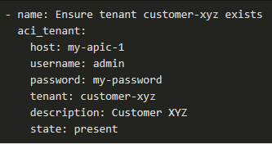
Cisco Network Management Cisco ACI - Ansible Modules
Ansible modules for ACI (and MSO)
Cisco and the wider community have collaborated on a broad suite of open source modules for Ansible. Thus, enabling configuration and management of ACI fabrics as code, alongside other Ansible-managed inventory.
Modules have also been created to address multi-site and hybrid cloud resources via the Multi-Site Orchestrator (MSO) APIs.
The ACI/MSO modules permit the simple creation of playbook elements to perform inquiry, administration, and management tasks upon an ACI fabric.
For example, the task in the figure, drawn from Ansible documentation, idempotently ensures that a given tenant account exists (creating it, if not). It uses the aci_tenant module, which provides a range of tenant-management functionality.
Notes:
8 – Cisco Platforms and Development
8.4 - Cisco Network Management
8.4.8 - Cisco ACI - Ansible Modules
Instructor Notes:
Visit the website for Cobra installation Documentation

Slide 44
Cisco Network Management Cisco ACI - Ansible Modules (Contd.)
Cisco ACI REST API Example
The APIC CLI, GUI, and SDK use the same REST API interface so that whenever information is displayed and configuration changes are made, the data is read and written through the REST API, respectively.
Distinguished Name (DN) - Identifies a specific target object, letting you map the name directly to URLs.
Relative Name (RN) - Names the object apart from its siblings within the context of a parent object.
Object instances are referred to as Managed Objects (MOs).
Every MO in the system can be identified by a unique DN.
With the MO and its DN, you can refer to any object globally.
In addition to a DN, you can refer to each object by its RN.
The RN identifies an object relative to its parent object.
Notes:
8 – Cisco Platforms and Development
8.4 - Cisco Network Management
8.4.8 - Cisco ACI - Ansible Modules
Instructor Notes:
Visit the website for Cobra installation Documentation

Slide 45
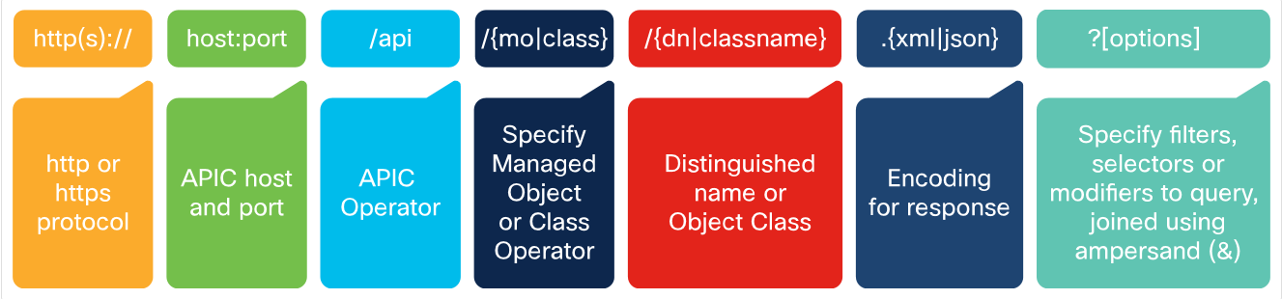
Cisco Network Management Cisco ACI URL Format
ACI URL Format
A URI provides access to a target resource.
The literal string api, indicates that the API is to be invoked.
The final mandatory part of the request URI is the encoding format: either .xml or .json.
The REST API supports a wide range of flexible filters.
One of the most common use cases for this API is for monitoring the Cisco ACI Fabric.
Notes:
8 – Cisco Platforms and Development
8.4 - Cisco Network Management
8.4.9 - Cisco ACI URL Format

Slide 46
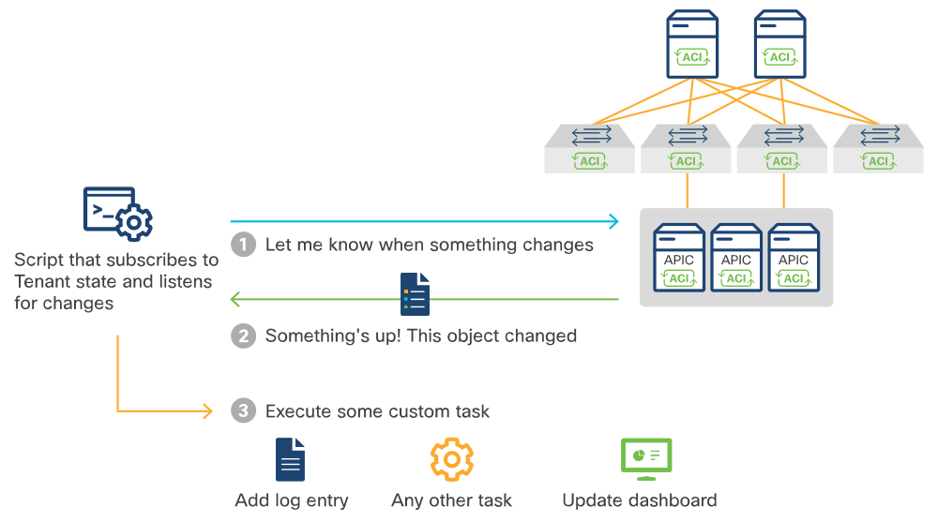
Cisco Network Management Cisco ACI URL Format (Contd.)
Besides manual querying, you can gather information automatically and then apply policies, minimizing the opportunities for human error.
When you start using automation when monitoring the ACI fabric, you can build various applications that can execute different tasks if there is a specific change in the network.
Proactive monitoring of the ACI fabric
Notes:
8 – Cisco Platforms and Development
8.4 - Cisco Network Management
8.4.9 - Cisco ACI URL Format

Slide 47
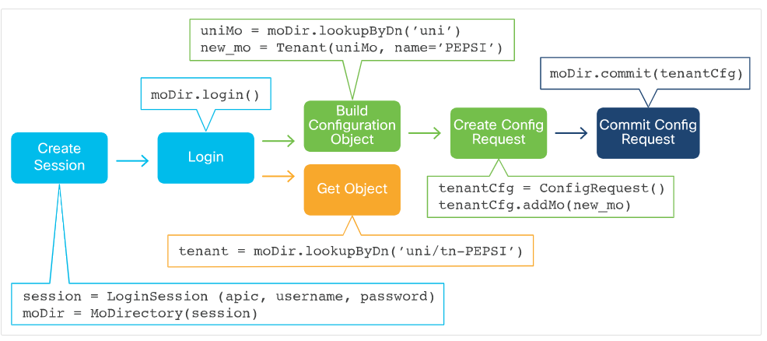
Cisco Network Management Cisco ACI Cobra
To simplify application development with ACI, Cisco has developed Cobra, a robust Python library for the APIC REST API.
Cobra SDK can be used to manipulate the MIT generally through the below workflow:
Create a Session Object.
Log in to Cisco APIC.
Create a Configuration Object.
Create a Configuration Request Object.
Add your Config Object to the Request.
Commit
Workflow of the Cobra SDK Objects
Notes:
8 – Cisco Platforms and Development
8.4 - Cisco Network Management
8.4.10 - Cisco ACI Cobra

Slide 48
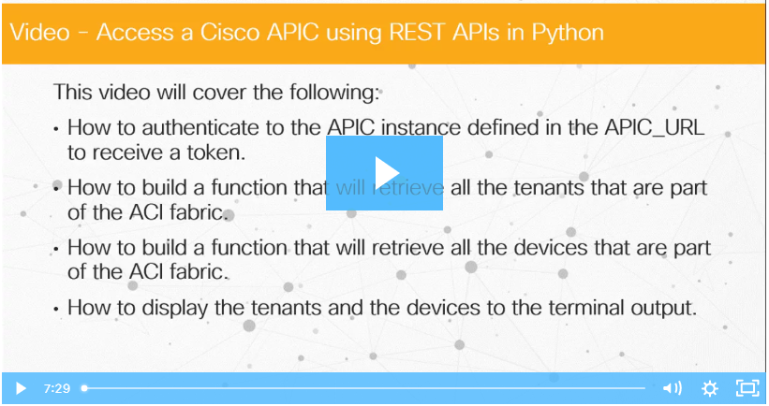
Cisco Network Management Video – Access a Cisco APIC using REST APIs in Python
Watch the video to learn how to access a Cisco APIC Using REST APIs in Python
Notes:
8 – Cisco Platforms and Development
8.4 - Cisco Network Management
8.4.11 - Video – Access a Cisco APIC Using REST APIs in Python

Slide 49
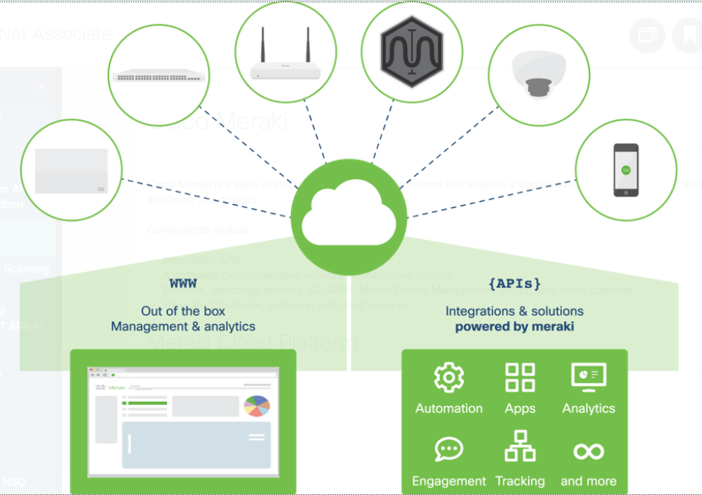
Cisco Network Management Cisco Meraki
Cisco Meraki is a suite of cloud-managed network solutions that enables a single source of management for infrastructure, locations, and devices.
Components include:
Integration APIs
A complete cloud-managed network infrastructure solution
Wireless, switching, security, SD-WAN, Mobile Device Management (MDM), and smart cameras
Integrated hardware, software, and cloud services
Meraki Cloud Platform
Notes:
8 – Cisco Platforms and Development
8.4 - Cisco Network Management
8.4.12 - Cisco Meraki

Slide 50
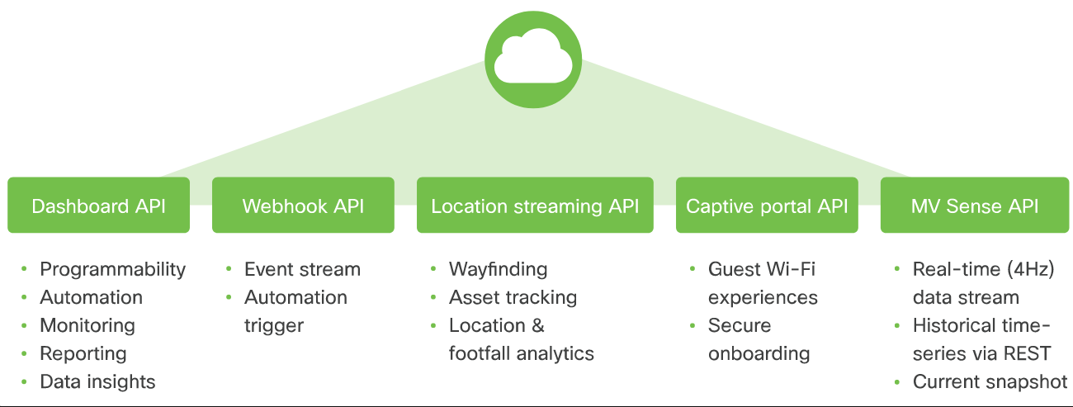
Cisco Network Management Cisco Meraki (Contd.)
Meraki Integrations
The Meraki enterprise cloud-managed networking infrastructure service has five different APIs for integration as seen below.
Meraki API services
Notes:
8 – Cisco Platforms and Development
8.4 - Cisco Network Management
8.4.12 - Cisco Meraki

Slide 51
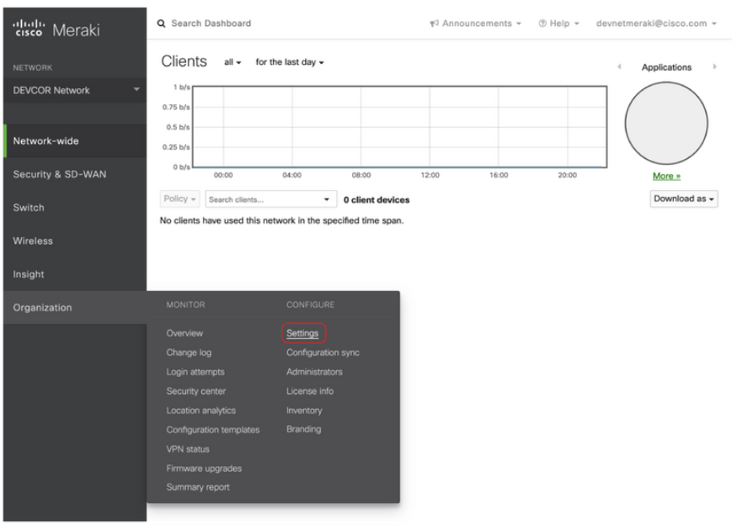
Cisco Network Management Cisco Meraki (Contd.)
Meraki Dashboard API
The Cisco Meraki Dashboard API is a RESTful API that uses HTTPS for transport and JSON for object serialization.
To provide access to the API for an organization, first enable the API for the organization under Organization › Settings.
Note: These instructions are an example only. To complete these steps, you need to be a user with administrator access in a Meraki organization. The Meraki organization in this course has API access already and the API key is provided in the examples.
Notes:
8 – Cisco Platforms and Development
8.4 - Cisco Network Management
8.4.12 - Cisco Meraki

Slide 52
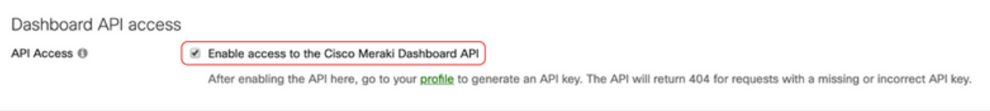
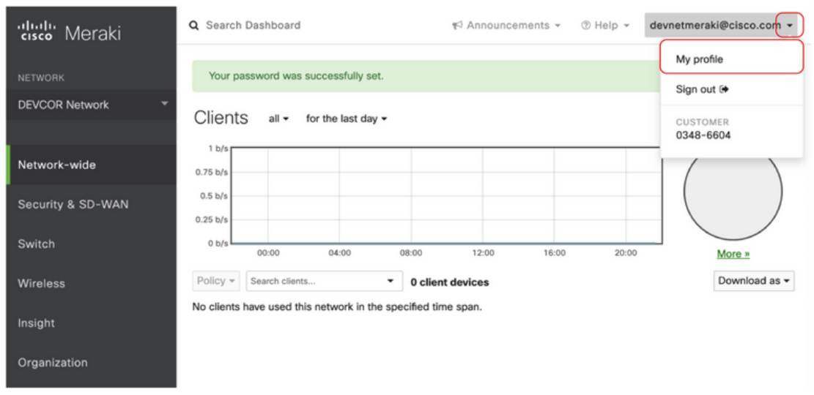
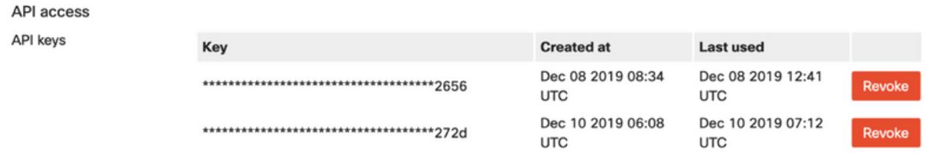
Cisco Network Management Cisco Meraki (Contd.)
Scroll down.
After enabling the API, go to the My Profile page to generate an API key. The API key is associated with a Meraki Dashboard administrator account. The API key needs to be kept safe, as it provides authentication to all of the organizations that have the API enabled.
Notes:
8 – Cisco Platforms and Development
8.4 - Cisco Network Management
8.4.12 - Cisco Meraki

Slide 53
Cisco Network Management Cisco Meraki Location Scanning API
Location analytics:
The Location Scanning API can be used by retail stores with multiple locations, conference deployments where location information can be useful for attendees, or deployments where the business wants to know trends in user engagement.
Bluetooth Scanning API
Meraki Access Points (APs) can detect and locate Bluetooth Low Energy (BLE) devices when they are nearby.
Location and privacy
Meraki Smart Cameras can perform object detection, classification, and direct tracking on the edge of the network, thus placing the computing needs in the endpoint.
Camera API categories
The available camera APIs are MV Sense, Live Link API, and Snapshot API
Notes:
8 – Cisco Platforms and Development
8.4 - Cisco Network Management
8.4.13 - Cisco Meraki Location Scanning API

Slide 54
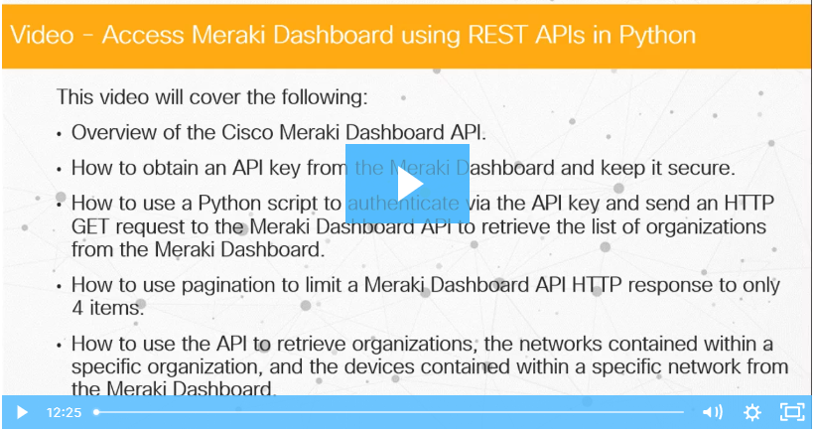
Cisco Network Management Video – Access Meraki Dashboard Using REST APIs in Python
Watch the video to learn how to access Meraki Dashboard Using REST APIs in Python.
Notes:
8 – Cisco Platforms and Development
8.4 - Cisco Network Management
8.4.14 - Video – Access Meraki Dashboard Using REST APIs in Python

Slide 55
Cisco Network Management Cisco NX-OS Platform
What is Cisco NX-OS Platform?
Nexus Operating System (NX-OS) is a data center operating system for the Nexus switch.
Nexus switches are highly performant in data centers and integrate with a lot of systems.
Architecture
Cisco Open NX-OS leverages the native Linux networking stack, instead of a custom-built userspace stack (NetStack) that was used in prior versions of NX-OS.
Nexus switch interfaces, including physical, port-channel, vPC, VLAN, and other logical interfaces, are mapped to the kernel as standard Linux netdevs.
Environment and scale
The Nexus family is performant and preferred by developers, DevOps professionals, and other users who want to provide self-service network infrastructure models.
The Cisco Nexus 9000 Series NX-OS Verified Scalability Guide document describes the Cisco NX-OS configuration limits for Cisco Nexus 9000 Series switches.
Notes:
8 – Cisco Platforms and Development
8.4 - Cisco Network Management
8.4.15 – Cisco NX-OS Platform

Slide 56
Cisco Network Management Cisco NX-OS Platform (Contd.)
Container support
NX-OS supports running Linux Containers (LXCs) directly on the platform. It provides access to a CentOS 7-based Guest Shell, which supports custom functionality directly on the device in a secure, isolated shell.
Telemetry
You can integrate different telemetry applications such as Ganglia, Splunk, or Nagios on the switch with NX-OS.
Open NX-OS programmatic interfaces
Open NX-OS is the set of software used to provide the APIs, data models, and programmatic access including the NX-API REST service and model-driven programmability using YANG modeling.
Open NX-OS includes the native NX-OS data model in the software image itself. If you are only using Open NX-OS, you do not have to download additional models.
Notes:
8 – Cisco Platforms and Development
8.4 - Cisco Network Management
8.4.15 – Cisco NX-OS Platform

Slide 57
Cisco Network Management Cisco NX-OS Platform (Contd.)
YANG, NETCONF, and RESTCONF
Cisco NX-OS supports YANG models through the interfaces of NETCONF, RESTCONF on Open NX-OS.
The Cisco NX-OS employs a NETCONF agent as a client-facing interface to provide secure transport for the client requests and server responses.
Enabling Model Driven Programmability features in NX-OS
Enable the following features on the switch using CLI or another method (such as NX-API). Enable the transport protocols that you want to leverage.
Note: These instructions apply to Open NX-OS 9.2.1+. Previous versions of Open NX-OS require manual installation and activation of RPMs for the protocol agents. See the Programming Guides for your platform if you are using an earlier version.
Notes:
8 – Cisco Platforms and Development
8.4 - Cisco Network Management
8.4.15 – Cisco NX-OS Platform

Slide 58
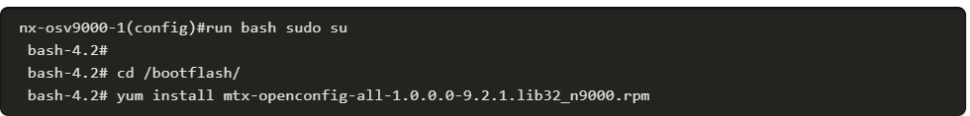
Cisco Network Management Cisco NX-OS Platform (Contd.)
OpenConfig
OpenConfig models supported by Open NX-OS can be downloaded from Cisco Artifactory Open NX-OS Agents.
Download the desired models to your local workstation, and then copy them to the Open NX-OS switch where you want to install them.
Use the bash-shell feature on Open NX-OS to install the newly copied RPM files. Ensure that the feature bash-shell must be enabled on your switch.
Notes:
8 – Cisco Platforms and Development
8.4 - Cisco Network Management
8.4.15 – Cisco NX-OS Platform

Slide 59
Cisco Network Management Cisco NSO
What is Cisco NSO?
Network Services Orchestrator (NSO) enables operators to adopt the service configuration solution dynamically, according to changes in the offered service portfolio.
NSO has three components:
Device and service abstraction layers
Configuration database
Model-driven programmable interface (YANG models)
Device and service abstraction layers
NSO uses the standardized YANG modeling language to model and automate any type of device.
The data model for a service correlates service definitions with network operations.
For device data models, NSO recognizes and can work across the physical devices in a data center, including firewalls and other OSI model Layer 4 through Layer 7 devices.
NSO can automate the launch, configuration, monitoring, and license management of Virtual Network Functions (VNFs).
Notes:
8 – Cisco Platforms and Development
8.4 - Cisco Network Management
8.4.16 – Cisco NSO

Slide 60
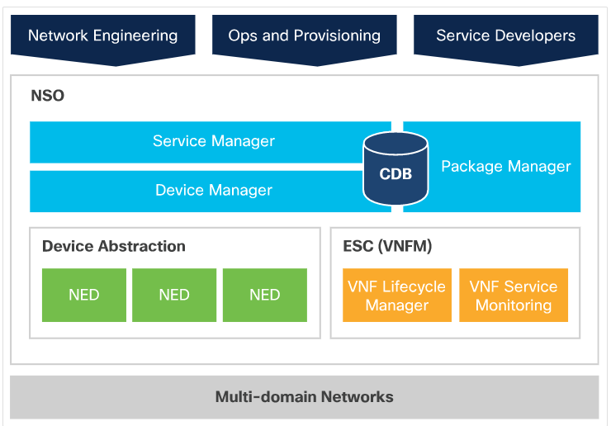
Cisco Network Management Cisco NSO (Contd.)
Functional architecture
The NSO architecture is logically comprised of two layers:
Device Manager - Simplifies device integration and manages different devices using a YANG and NETCONF view. Whether the interface is SNMP or CLI, the Device Manager creates a transactional change sequence for the target devices.
Service Manager - Lets you develop service-aware applications to configure devices. The Service Manager handles the complete lifecycle (creating, modifying, and deleting) of service instances.
NSO Functional Architecture
Notes:
8 – Cisco Platforms and Development
8.4 - Cisco Network Management
8.4.16 – Cisco NSO

Slide 61
Cisco Network Management Cisco NSO (Contd.)
Configuration Database:
NSO uses an internal Configuration Database (CDB) to store its own configuration, the configuration of all services, as well as a copy of the configuration of all managed devices.
The NSO CDB provides:
A model on how to handle configuration data in network devices.
An internal API for locating network element configurations.
Automatic support for upgrade and downgrade of configuration data.
CDB client applications need to be able to read configuration data from the database and react when configurations are updated.
Note: The CDB journaling requires file system providing sufficient minimal performance and primitives must include file synchronization and truncation. NFS and other network file systems are unsuitable and unsupported for use with CDB in production deployment.
Notes:
8 – Cisco Platforms and Development
8.4 - Cisco Network Management
8.4.16 – Cisco NSO

Slide 62
Cisco Network Management Cisco NSO (Contd.)
YANG models
In YANG, data models are represented by definition hierarchies called schema trees. In NSO, there are three primary YANG sources:
NSO data-model - This defines the built-in functions of NSO.
Data models - Data models from devices such as native YANG modules from NETCONF devices, generated YANG modules from SNMP MIBs, or reverse engineered YANG modules from a CLI device. These YANG modules then specify the functions of the devices that are integrated to NSO.
YANG service models - When developing service applications, a developer specifies the service model, such as a BGP peer, firewall setting, or MPLS VPN, in YANG.
Notes:
8 – Cisco Platforms and Development
8.4 - Cisco Network Management
8.4.16 – Cisco NSO

Slide 63
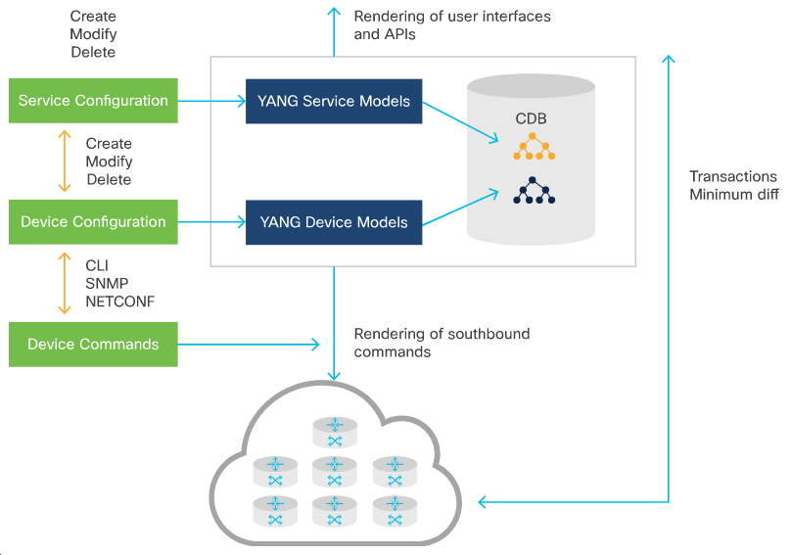
Cisco Network Management Cisco NSO (Contd.)
Service model design
A Service in NSO consists of the following:
A YANG service model - This defines the attributes of the service.
A device configuration mapping - When the service is created, corresponding changes must be made to the devices. These are defined using either service templates or programmatically using Java.
NSO Service Mapping
Note: While most of the validation can be expressed in YANG, in some cases, the configuration data validation will require external code, such as when performing look-ups in databases. This step is developed using MAAPI
Notes:
8 – Cisco Platforms and Development
8.4 - Cisco Network Management
8.4.16 – Cisco NSO

Slide 64
Cisco Network Management Cisco NSO Services
What is Cisco NSO Service?
An NSO service is a function provided by network devices.
Northbound interfaces
Allow integration of NSO with applications and portals.
Available northbound interfaces: REST API, CLI, NETCONF, Web UI, SNMP, Java, and so on
Note: The legacy REST API has been deprecated since NSO 5.1 and is scheduled to be removed in NSO 5.3.
Command line interface (CLI)
NSO CLI is a single interface for network devices and network services. It comes in two flavors: Juniper-style and Cisco XR-style.
Web user interface
The NSO Web UI is a YANG model browser with additional device and service functionality. The interface is built with pure client-side JavaScript.
Notes:
8 – Cisco Platforms and Development
8.4 - Cisco Network Management
8.4.17 – Cisco NSO Services

Slide 65
Cisco Network Management Cisco NSO Services (Contd.)
Managing services (southbound)
NSO requires a YANG model, device address, management port, and authentication credentials for each device to be managed.
A name identifies each managed device.
Southbound interfaces
Allow the configuration and management of network elements.
Available Southbound interfaces are: NETCONF, SNMP, CLI, IOS, IOS XR, and so on.
Adding devices
A new device can be added into NSO using any of the following methods:
Discovery
Manually
Cloning
Templates
Notes:
8 – Cisco Platforms and Development
8.4 - Cisco Network Management
8.4.17 – Cisco NSO Services

Slide 66
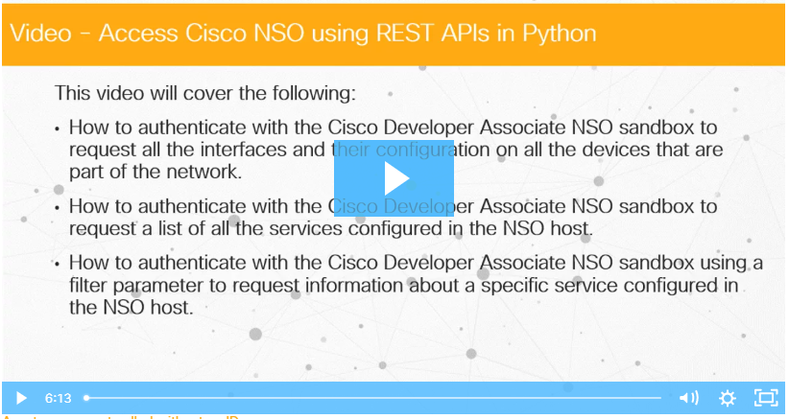
Cisco Network Management Video – Access Cisco NSO Using REST APIs in Python
Watch the video to learn how to access Cisco NSO Using REST APIs in Python
Notes:
8 – Cisco Platforms and Development
8.4 - Cisco Network Management
8.4.18 - Video – Access Cisco NSO Using REST APIs in Python

Slide 67
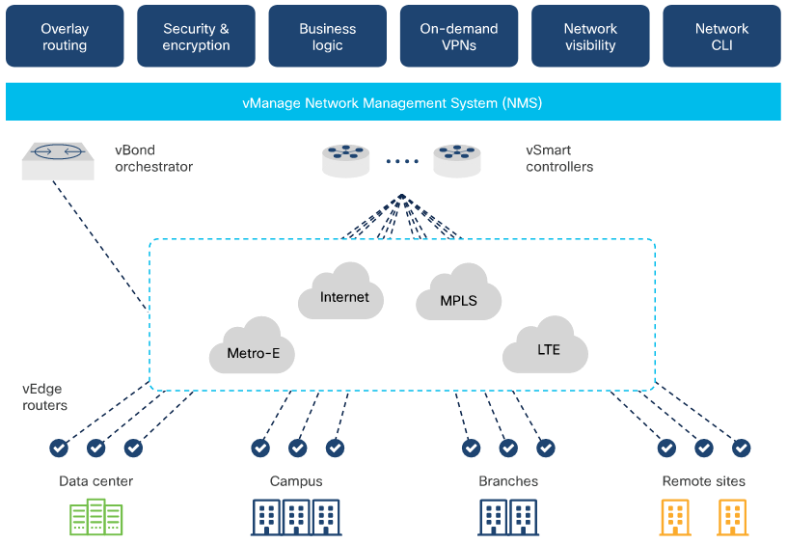
Cisco Network Management Cisco SD WAN
Through a dashboard called vManage, Cisco SD-WAN provides:
Transport independence - Guaranteeing zero network downtime, Cisco SD-WAN automates application flexibility over multiple connections.
Network services - Deliver rich networking and security services with clicks on the dashboard.
Endpoint flexibility - Simplify connectivity across branches, campuses, data centers, or cloud environments, extending the SD-WAN fabric wherever you need it to go.
SD-WAN Overview
Notes:
8 – Cisco Platforms and Development
8.4 - Cisco Network Management
8.4.19 – Cisco SD WAN

Slide 68
Cisco Network Management Cisco SD WAN (Contd.)
Key features of Cisco SD-WAN
Cloud-first architecture
Embedded security
Predictable application experience
Cisco SD-WAN components
vManage Network Management System (NMS): Centralized network management system, so that you can configure overlay networks from a dashboard.
vSmart Controller: Controls the flow of data traffic by working with the vBond orchestrator to authenticate SD-WAN devices as they join the network.
vBond Orchestrator: Orchestrates connectivity between vEdge routers and vSmart controllers.
vEdge Routers: Provisioned at the perimeter of a site and delivered as hardware, software, cloud or virtualized components, vEdge Routers secure virtual overlay network over a mix of WAN transports.
Notes:
8 – Cisco Platforms and Development
8.4 - Cisco Network Management
8.4.19 – Cisco SD WAN

Slide 69
Cisco Network Management Cisco SD WAN (Contd.)
Cisco SD WAN APIs
The Cisco SD-WAN software provides a REST API, which is a programmatic interface for controlling, configuring, and monitoring the devices in an overlay network.
The Cisco SD-WAN REST API calls expose the functionality of the software and hardware features or of the normal operations you perform to maintain SD-WAN devices and the overlay network itself. Each of these features or operations is called a resource.
Resources are grouped into collections. The SD-WAN REST API resources are grouped into the following collections:
Administration
Certificate Management
Configuration
Device Inventory
Monitoring
Real-Time Monitoring
Troubleshooting Tools
Notes:
8 – Cisco Platforms and Development
8.4 - Cisco Network Management
8.4.19 – Cisco SD WAN
Instructor Notes:
Let the class explore the API documentation > apidocs resource.

Slide 70
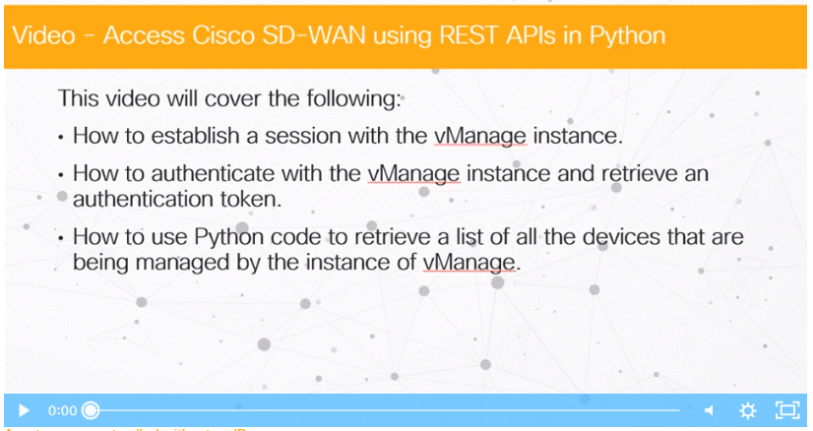
Cisco Network Management Video – Access Cisco SD-WAN Using REST APIs in Python
Watch the video to learn how to access the Cisco SD-WAN Using REST APIs in Python
Notes:
8 – Cisco Platforms and Development
8.4 - Cisco Network Management
8.4.20 - Video – Access Cisco SD-WAN Using REST APIs in Python

Slide 71
8.5 Cisco Compute Management
Notes:
Source:
8 – Cisco Platforms and Development
8.5 - Cisco Compute Management
In-Session Activities / Explanations:
Time: 25 min
Instructor Notes:
Briefly explain Cisco UCS Manager
Describe the GUI of Cisco UCS Manager
Explain the Cisco UCS Management Information Model.
Discuss Cisco UCS Managed Objects including object naming, object classes and authentication, query, and configuration methods.
Describe the UCS Manager Documentation
Explain UCS PowerTool
Explain Cisco Director
Walk the learners through Cisco Intersight
Key Points: UCS-Manager, UCS-Director, SaaS, Intersight

Slide 72
Cisco Compute Management Cisco Compute Solutions
The Cisco Unified Computing System (UCS), along with its software and SaaS adjuncts provides a complete physical and logical plant for compute, networking, and storage in the modern datacenter.
UCS tools and services: UCS-Manager, UCS-Director, SaaS global infrastructure management system, and Intersight.
UCS is ‘hyperconverged’ infrastructure.
In very abstract terms, UCS virtualizes physical infrastructure and makes it uniformly software-definable.
Notes:
8 – Cisco Platforms and Development
8.5 - Cisco Compute Management
8.5.1 - Cisco Compute Solutions

Slide 73
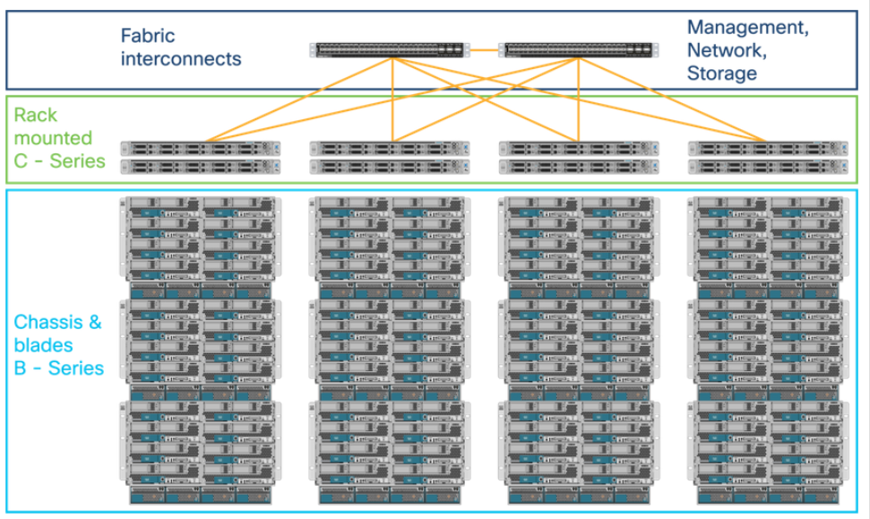
Cisco Compute Management Cisco UCS Manager
The Cisco Unified Computing System (UCS) is a data center server computer product line composed of computing hardware, switching fabric, embedded management software, and virtualization support.
The products provide scalability by integrating many components of a data center. This lets users manage them as a single unit through UCS Manager, UCS Central, and the Cisco Integrated Management Controller.
Cisco UCS Manager Server Overview
Notes:
8 – Cisco Platforms and Development
8.5 - Cisco Compute Management
8.5.2 - Cisco UCS Manager

Slide 74
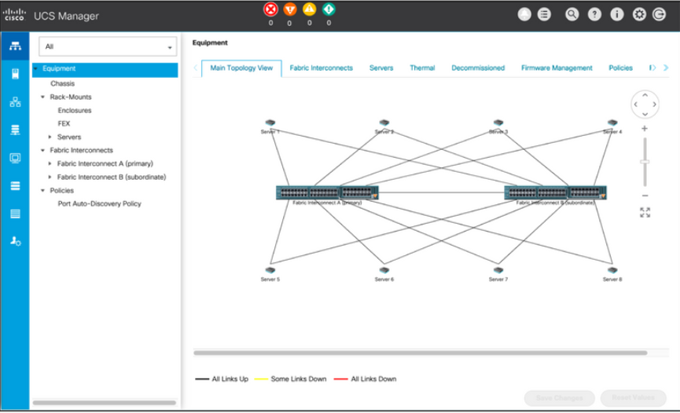
Cisco Compute Management Cisco UCS Manager (Contd.)
Cisco UCS Manager runs on the primary fabric interconnect and is assigned a Virtual IP address (VIP) with failover capability to the subordinate fabric interconnect.
Cisco UCS Manager mediates all communication within the system
Cisco UCS Manager is aware of the current configuration and performs automated device discovery whenever a new resource is installed.
After a resource is detected, Cisco UCS Manager adds it and its characteristics to the system inventory.
Cisco UCS Manager Graphical Interface
Notes:
8 – Cisco Platforms and Development
8.5 - Cisco Compute Management
8.5.2 - Cisco UCS Manager

Slide 75
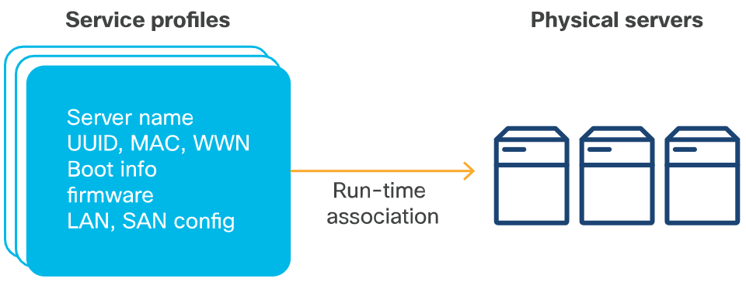
Cisco Compute Management Cisco UCS Manager (Contd.)
Applying abstraction to servers
Cisco UCS Management software provides an abstraction layer between server component interfaces and the administrator.
The abstraction layer is presented as a web-based GUI, an SSH CLI, and API.
Cisco UCS Service Profiles
Cisco UCS Manager uses Service Profiles to assign identity to a server when a Service Profile is associated with a server.
Each UCS server can only have a single Service Profile association at a time.
Service Profiles can be disassociated from one server and associated to another.
Service Profile Application to Physical servers
Notes:
8 – Cisco Platforms and Development
8.5 - Cisco Compute Management
8.5.2 - Cisco UCS Manager

Slide 76
Cisco Compute Management Cisco UCS Manager Servers
Cisco UCS Manager servers
Cisco UCS Manager servers are either blades that reside in chassis (B-Series Servers) or rack-mounted (C-Series servers). Both are connected to a redundant pair of switches called UCS Fabric Interconnects (FIs).
When the servers in a UCS system are configured, there should not be a single point of failure.
UCS Manager keeps track of events, alerts, errors, and statistics. It is able to report these items using various industry-standard management protocols like SNMP and Syslog.
Cisco UCS Unified API
Cisco UCS Unified uses the same API methodology that is used for the CIMC, Cisco UCS Manager, and Cisco UCS Central.
Notes:
8 – Cisco Platforms and Development
8.5 - Cisco Compute Management
8.5.3 - Cisco UCS Manager Servers

Slide 77
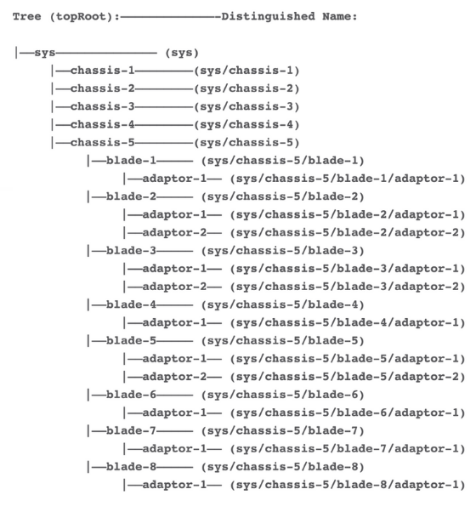
Cisco Compute Management Cisco UCS Manager Servers (Contd.)
Cisco UCS Management Information Model
All the physical and logical components that comprise Cisco UCS are represented in a hierarchical Management Information Model (MIM), also referred to as the MIT.
MIT is a tree structure with nodes, where each node in the tree represents a Managed Object (MO) or a group of objects that contains the nodes' administrative state and its operational state.
The hierarchical structure starts at the top (sys) and contains the parent and child nodes.
Cisco UCS MIT Hierarchical Structure
Notes:
8 – Cisco Platforms and Development
8.5 - Cisco Compute Management
8.5.3 - Cisco UCS Manager Servers

Slide 78
Cisco Compute Management Cisco UCS Managed Objects
What are Cisco UCS Managed Objects?
Cisco UCS Managed Objects are XML representations of a physical and logical entities in the UCS system.
A UCS managed object can have many attributes and can contain many children, the children objects can also contain many children, and so on.
Object naming
A specific object can be identified by its Distinguished Name or by its Relative Name (RN).
The DN has the following format consisting of a series of RNs: dn = {rn}/{rn}/{rn}/{rn}.
The Relative Name (RN) identifies an object within the context of its parent object. The DN is composed of a sequence of RNs.
Object classes
All managed objects belong to a class indicating the type of UCS resource the object represents.
Notes:
8 – Cisco Platforms and Development
8.5 - Cisco Compute Management
8.5.4 - Cisco UCS Managed Objects

Slide 79
Cisco Compute Management Cisco UCS Managed Objects (Contd.)
UCS XML API
The Cisco UCS Manager XML API, like other APIs, provides methods to authenticate, query, and configure.
Authentication methods
Authentication methods authenticate and maintain an API session with UCS Manager:
aaaLogin - Initial method for logging in and retrieving an authentication cookie. cookie.
aaaRefresh - Refreshes the current authentication cookie.
aaaLogout - Exits the current session and deactivates the authentication cookie.
Notes:
8 – Cisco Platforms and Development
8.5 - Cisco Compute Management
8.5.4 - Cisco UCS Managed Objects

Slide 80
Cisco Compute Management Cisco UCS Managed Objects (Contd.)
Query methods
Query methods obtain information on the current configuration state of an object. The following are query examples:
configResolveDn - Retrieves objects by DN.
configResolveDns - Retrieves objects by a set of DNs.
configResolveClass - Retrieves objects of a given class.
configResolveClasses - Retrieves objects of multiple classes.
configFindDnsByClassId - Retrieves the DNs of a specified class.
configResolveChildren - Retrieves the child objects of an object.
configResolveParent - Retrieves the parent object of an object.
configScope—Performs - Performs class queries on a DN in the MIT.
Notes:
8 – Cisco Platforms and Development
8.5 - Cisco Compute Management
8.5.4 - Cisco UCS Managed Objects

Slide 81
Cisco Compute Management Cisco UCS Managed Objects (Contd.)
Configuration methods
There are several methods to make configuration changes to managed objects.
These changes can be applied to the whole object tree, a subtree rooted at a specified object, or an individual object. The following are examples of configuration methods:
configConfMo - Affects a single managed object.
configConfMos - Affects multiple subtrees.
configConfMoGroup - Applies the same configuration changes to multiple subtree structures or managed objects.
Notes:
8 – Cisco Platforms and Development
8.5 - Cisco Compute Management
8.5.4 - Cisco UCS Managed Objects

Slide 82
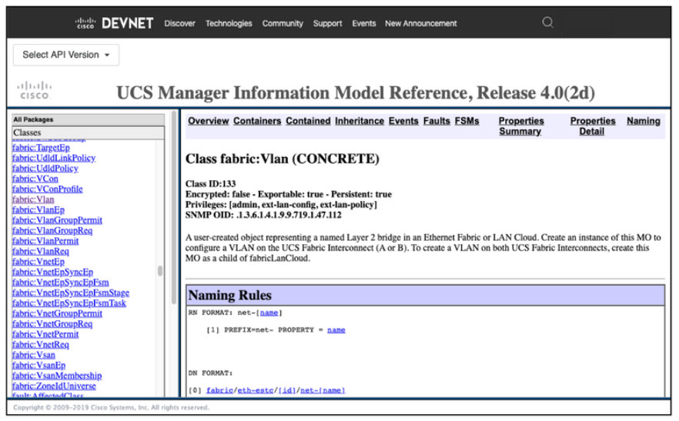
Cisco Compute Management Cisco UCS Managed Objects (Contd.)
Cisco UCS API documentation
Cisco UCS API documentation is typically referred to as the UCS Object Model documentation.
The Object Model documentation is available with the UCS Platform Emulator or online.
Every UCS object class and method is listed in the documentation along with UCS types, events, faults, errors, and Syslog messages.
UCS Object Model Documentation - Overview and Naming Rules
Notes:
8 – Cisco Platforms and Development
8.5 - Cisco Compute Management
8.5.4 - Cisco UCS Managed Objects

Slide 83
Cisco Compute Management Cisco UCS Manager Documentation
The left navigation menu enables you to select an object.
The right pane displays the object information divided into the following sections:
Overview: Indicates if the object is Abstract or Concrete.
Naming Rules: Indicate the object prefix.
Containers Hierarchies: Displays where the object can reside in the MIM.
Contained Hierarchies: Displays what objects the fabricVlan can contain and what objects those contained objects can contain, and so on.
Inheritance: Displays all the objects prior to the fabricVlan object that the fabricVlan inherited attributes from.
Events, faults, and FSMs: Objects that are attached to the parent object for which they are generated.
Properties Summary: Lists all the properties or attributes of the object.
Properties Detail: Each object property is defined completely in the Properties Detail.
Notes:
8 – Cisco Platforms and Development
8.5 - Cisco Compute Management
8.5.5 - Cisco UCS Manager Documentation

Slide 84
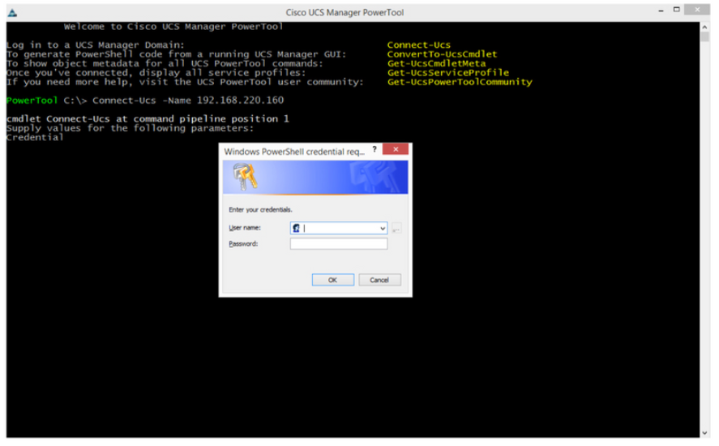
Cisco Compute Management Cisco UCS Power Tool
UCS PowerTool is a library of PowerShell Cmdlets that enable the management of UCS environments from Microsoft Operating Systems, via the UCS XML API.
Cmdlets ensure that they are completely aware of objects, their containment, properties and the details associated with each property.
The Cmdlet to authenticate with a UCS Manager is as follows:
Connect-Ucs -Name <ip-address-ucs-manager>
UCS PowerTool - Authentication
Notes:
8 – Cisco Platforms and Development
8.5 - Cisco Compute Management
8.5.6 - Cisco UCS Power Tool

Slide 85
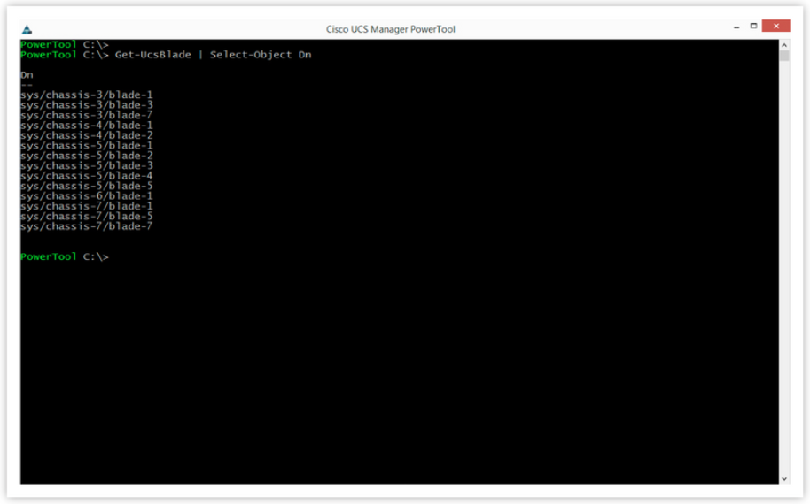
Cisco Compute Management Cisco UCS Power Tool (Contd.)
The Cmdlet to query UCS Blades and view their DNs is: Get-UcsBlade | Select-Object Dn
The Cmdlet to create UCS VLAN 100 is:
Get-UcsLanCloud | Add-UcsVlan-Name vlan100 -Id 100
UCS PowerTool - Blade Query
Notes:
8 – Cisco Platforms and Development
8.5 - Cisco Compute Management
8.5.6 - Cisco UCS Power Tool

Slide 86
Cisco Compute Management Cisco UCS Power Tool (Contd.)
UCS PowerTool OS support
UCS PowerTool is a library of PowerShell Cmdlets.
UCS PowerTool has nearly 6000 Cmdlets to manage every aspect of Cisco UCS Systems.
UCS Python SDK
UCS Python SDK is a set of Python modules, each containing one or more classes, developed specifically to automate UCS Manager via the UCS XML API.
Similar to UCS PowerTool, the UCS Python SDK provides hundreds of Python modules to interact with UCS objects.
Notes:
8 – Cisco Platforms and Development
8.5 - Cisco Compute Management
8.5.6 - Cisco UCS Power Tool

Slide 87
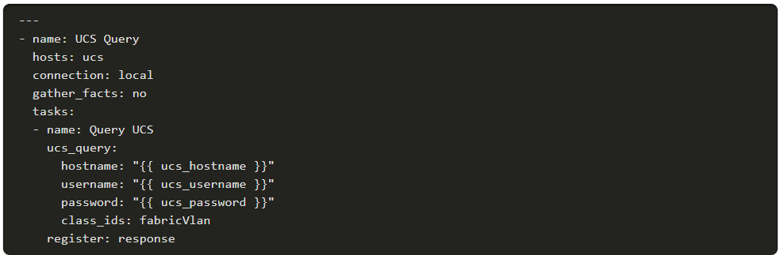
Cisco Compute Management Cisco UCS Power Tool (Contd.)
UCS Ansible
UCS Ansible is available for UCS Manager and the Cisco Integrated Management Controller. UCS Ansible combines the UCS Manager authentication with the object mutation or object query.
UCS Ansible modules are called as tasks in an Ansible playbook.
Ansible playbook that queries a UCS Manager for UCS VLANs is shown in the below figure.
Notes:
8 – Cisco Platforms and Development
8.5 - Cisco Compute Management
8.5.6 - Cisco UCS Power Tool

Slide 88
Cisco Compute Management Cisco UCS Director
What is Cisco UCS Director?
Cisco UCS Director is a complete, highly secure, end-to-end management, orchestration, and automation solution for a wide array of Cisco and non-Cisco data center infrastructure components, and for converged infrastructure solutions based on the UCS and Cisco Nexus platforms.
Management through Cisco UCS Director
Cisco UCS Director extends the unification of computing and networking layers through Cisco UCS to provide visibility and management of data center infrastructure components.
You can use Cisco UCS Director to configure, administer, and monitor supported Cisco and non-Cisco components.
Notes:
8 – Cisco Platforms and Development
8.5 - Cisco Compute Management
8.5.7 - Cisco UCS Director

Slide 89
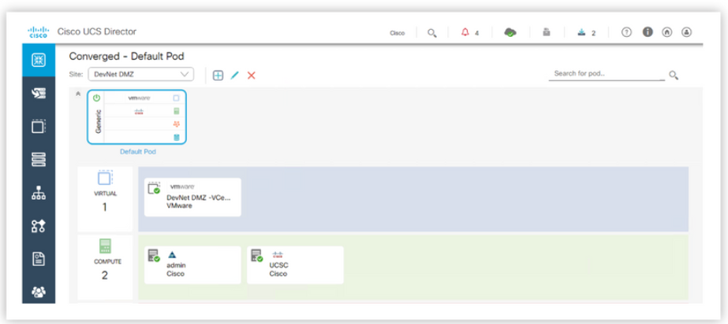
Cisco Compute Management Cisco UCS Director (Contd.)
Automation and orchestration with Cisco UCS Director
Cisco UCS Director enables you to build workflows that provide automation services and to publish the workflows and extend their services to your users on demand.
UCS Director Converged
Notes:
8 – Cisco Platforms and Development
8.5 - Cisco Compute Management
8.5.7 - Cisco UCS Director

Slide 90
Cisco Compute Management Cisco UCS Director (Contd.)
Features and benefits:
Central Management: Provides a single interface for administrators.
Self-service Catalog: Enables end users to order and deploy new infrastructure instances.
Adaptive Provisioning: Provides a real-time available capability, internal policies, and application workload requirements.
Dynamic Capacity Management: Provides continuous monitoring of infrastructure resources.
Multiple Hypervisor Support: Supports VMware ESX, ESXi, Microsoft Hyper-V, and Red Hat hypervisors.
Computing Management: Provisions, monitors, and manages physical, virtual, and bare metal servers, as well as blades.
Network Management: Provides policy-based provisioning of physical and virtual switches and dynamic network topologies.
Storage Management: Provides policy based provisioning and management of filers, virtual Filers (vFilers), Logical Unit Numbers (LUNs), and volumes.
Dashboards: Provides multiple dashboards to track resource and policy utilization.
Notes:
8 – Cisco Platforms and Development
8.5 - Cisco Compute Management
8.5.7 - Cisco UCS Director

Slide 91
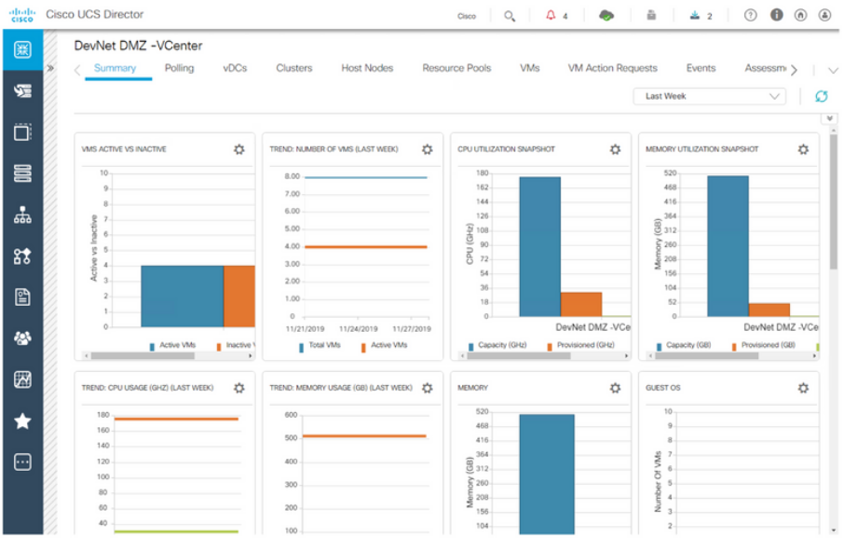
Cisco Compute Management Cisco UCS Director (Contd.)
Model-based orchestration
Cisco UCS Director includes a task library that contains over 1000 tasks and out-of-the-box workflows.
Model-based orchestration and a workflow designer enable you to customize and automate the infrastructure administrative and operational tasks.
UCS Director Dashboard
Notes:
8 – Cisco Platforms and Development
8.5 - Cisco Compute Management
8.5.7 - Cisco UCS Director

Slide 92
Cisco Compute Management Cisco UCS Director – REST API
To access the REST API through Cisco UCS Director, a valid Cisco UCS Director user account and an API access key are needed.
Cisco UCS Director uses the API access key to authenticate API requests.
This access key is a unique security access key code that is associated with a specific Cisco UCS Director user account.
You must pass the REST API access key as an HTTP header in the following format:
X-Cloupia-Request-Key: F90ZZF12345678ZZ90Z12ZZ3456FZ789
Notes:
8 – Cisco Platforms and Development
8.5 - Cisco Compute Management
8.5.8 - Cisco UCS Director – REST API

Slide 93
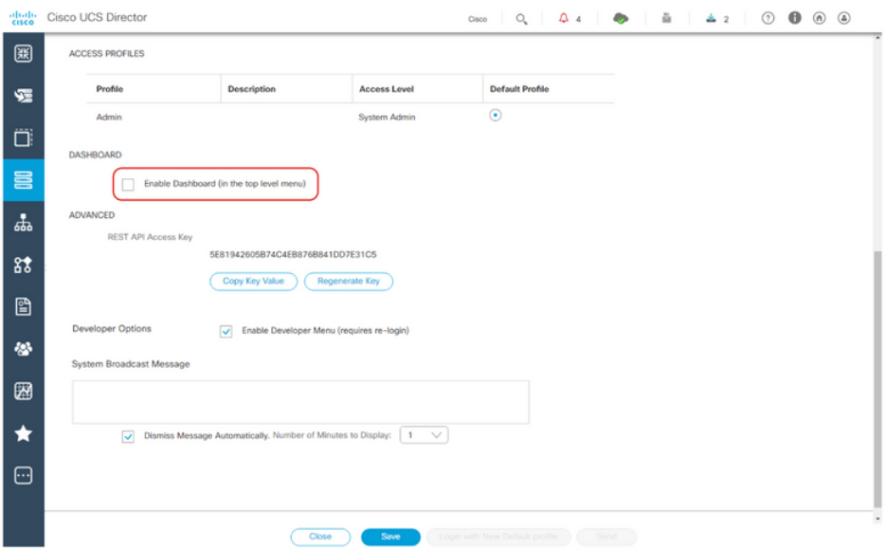
Cisco Compute Management Cisco UCS Director – REST API (Contd.)
Using the GUI
When you enable the developer menu, Cisco UCS Director GUI provides a developer menu option for developers to access the report metadata and REST API Browser. You can then access the following features:
Report Metadata
REST API Browser
REST Client
UCS Director Enable REST API Browser
Notes:
8 – Cisco Platforms and Development
8.5 - Cisco Compute Management
8.5.8 - Cisco UCS Director – REST API

Slide 94
Cisco Compute Management Cisco UCS Director – REST API (Contd.)
How to make a REST API request
API clients use an HTTP request to interact with Cisco UCS Director.
To pass the REST API access key, each request must be associated with an HTTP header called X-Cloupia-Request-Key with its value set to the current REST API access key.
Requests made to the API have the following characteristics:
They are sent over HTTP.
Request format encoding can be either JSON or XML in UCS Director API Version 1.
The request must contain a valid URL.
API VERSION 1
http://SERVER/app/api/rest?formatType=json&opName=operationName&opData=operationData
For details about encoding the URL, see the RFC at http://www.ietf.org/rfc/rfc1738.txt.
Notes:
8 – Cisco Platforms and Development
8.5 - Cisco Compute Management
8.5.8 - Cisco UCS Director – REST API

Slide 95
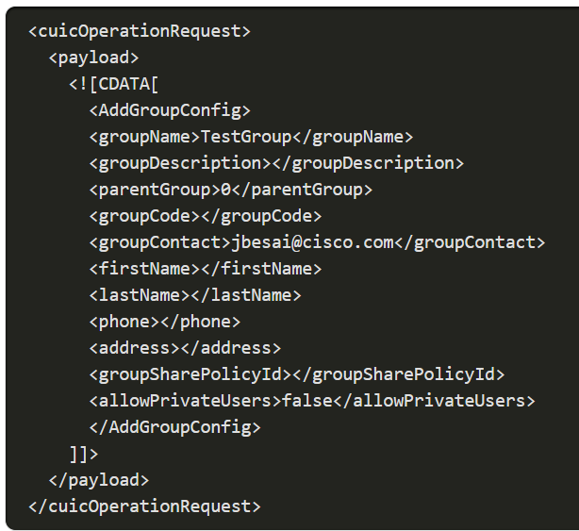
Cisco Compute Management Cisco UCS Director – REST API (Contd.)
API VERSION 2
Only XML is supported for Version 2 of the UCS Director API.
http://server/cloupia/api-v2/group
HTTP method: POST
How to use cURL commands?
cURL is a command line tool for getting or sending data using URL syntax.
The cURL command is used to execute a REST API request.
Notes:
8 – Cisco Platforms and Development
8.5 - Cisco Compute Management
8.5.8 - Cisco UCS Director – REST API

Slide 96
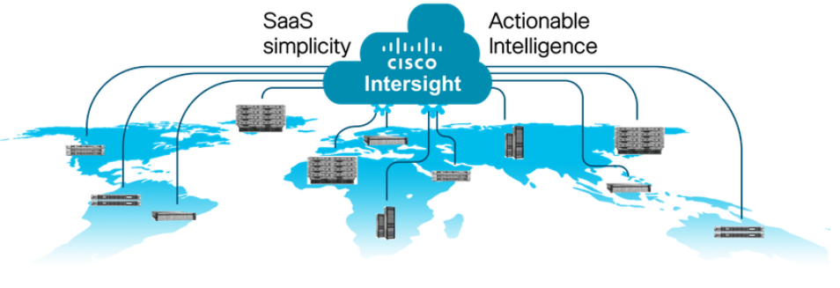
Cisco Compute Management Cisco Intersight
Cisco Intersight is a Software as a Service (SaaS) systems management platform capable of managing infrastructure at the edge and remote locations as well as in the data center.
The Intersight API is consistently available with a cloud-based management mode.
New features can be added to the service without impacting existing automation systems.
Cisco Intersight SaaS-based Management
Notes:
8 – Cisco Platforms and Development
8.5 - Cisco Compute Management
8.5.9 – Cisco Intersight

Slide 97
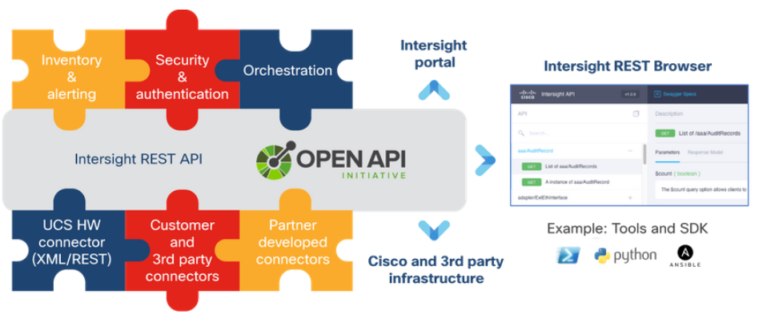
Cisco Compute Management Cisco Intersight (Contd.)
Intersight and Cisco Unified Computing System (UCS)
Cisco UCS Manager software provides an abstraction layer between the server component interfaces and the administrator.
The abstraction layer is presented as a web-based graphical user interface (GUI) and an application programming interface (API).
Cisco Intersight builds on the UCS Unified Fabric and UCS Management experience with a Cisco-hosted and maintained management platform
With the Intersight API you can build integrations with Cisco Intersight for additional tasks like monitoring, analysis, configuration, deployment, and orchestration.
Cisco Intersight API Framework
Notes:
8 – Cisco Platforms and Development
8.5 - Cisco Compute Management
8.5.9 – Cisco Intersight

Slide 98
Cisco Compute Management Cisco Intersight (Contd.)
Intersight API Capabilities
The Intersight API provides access to the Intersight MIM.
The Intersight API accepts and returns messages that are encapsulated through JavaScript Object Notation (JSON) documents and uses HTTP over TLS as the transport protocol.
All the physical and logical components visible in Cisco Intersight are represented in a hierarchical MIM, also referred to as the Management Information Tree (MIT).
Accessing the Intersight API
There are a couple of ways to gain access to the Intersight API:
Use a web browser as an Intersight API REST Client
Use API keys for remote or service access
Notes:
8 – Cisco Platforms and Development
8.5 - Cisco Compute Management
8.5.9 – Cisco Intersight

Slide 99
Cisco Compute Management Cisco Intersight (Contd.)
Ansible Modules for Cisco Intersight
Intersight supports several API integrations, including Ansible modules that enable inventory collection and configuration management of Intersight resources.
Ansible is written in Python, and the modules for Intersight interact with the API using the code written in Python.
Several example playbooks and Lab guides are hosted on GitHub.
Additional SDKs and resources
In addition to Ansible Modules, Intersight provides Python SDK and PowerShell modules that are generated from Intersight OpenAPI schema (which is also referred to as the Intersight Swagger Spec).
The intersight.com site hosts the latest OpenAPI specification and links to the SDKs.
Notes:
8 – Cisco Platforms and Development
8.5 - Cisco Compute Management
8.5.9 – Cisco Intersight

Slide 100
8.6 Cisco Collaboration Platforms
Notes:
Source:
8 – Cisco Platforms and Development
8.6 - Cisco Collaboration Platforms
In-Session Activities / Explanations:
Time: min
Instructor Notes:
Introduce Cisco Collaboration Platforms
Describe the collaboration tools and platforms offered by Cisco
Encourage the learners to perform the Hands-on Lab
Key Points: Unified Communications Manager (UCM), Contact Center, Finesse, Webex Teams.

Slide 101
Cisco Collaboration Platforms Introduction
Cisco Unified Communications Manager (Unified CM) - It is:
Used to configure and automate device provisioning, call routing, and profiles and settings management in a single solution.
Deployed in hospitals, banks, universities, and government agencies to manage the increasing number of devices and user profiles.
Contact Center - It provides robust customer support for call centers with agent desktop, supervisor, and reporting capabilities.
Finesse - It is an agent and supervisor desktop.
Webex - It encompasses Meetings, Teams, and Devices.
Webex Teams is a meetings and messaging app designed to improve collaboration.
Webex Devices include digital whiteboards, telepresence units, and room controls.
Notes:
8 – Cisco Platforms and Development
8.6 - Cisco Collaboration Platforms
8.6.1 – Introduction

Slide 102
Cisco Collaboration Platforms Cisco Unified Communications Manager
What is UCM?
Cisco Unified Communications Manager, also known as Unified CM, CUCM, or CallManager is:
an IP-based communications solution to support mobile and remote workers in small, medium, or enterprise-level businesses.
an integration for voice, video, and data into a single on-premise solution for call control and session management.
highly extensible, with various APIs for configuration, management, monitoring, and call control.
Purpose
The primary function of Unified CM is to manage phone users, IP phones, directory numbers, and to connect and manage calls to the desired destinations. With Unified CM you can:
Define gateways, trunks, remote destinations, and more telephony-related information.
Configure a full range of call handling tasks, including hold, transfer, call forward, and starting conference calls.
Notes:
8 – Cisco Platforms and Development
8.6 - Cisco Collaboration Platforms
8.6.2 – Cisco Unified Communications Manager

Slide 103
Cisco Collaboration Platforms Cisco Unified Communications Manager (Contd.)
Unified CM Advanced Features
Unified CM Advanced Features
AXL | UDS | Serviceability
Platform Administrative Web Services (PAWS) | Softphone compatibility | Extension Mobility
Cisco Jabber Voice & Video SDK | Java Telephony API (JTAPI) or Telephony API (TAPI) | Client Matter Codes (CMC)
Forced Authentication Codes | Hunt Lists | Music/Video on Hold
Extensions
Unified CM integrates with other services:
Cisco Instant Messaging and Presence (Cisco IM&P)
Voicemail
Contact Center
Notes:
8 – Cisco Platforms and Development
8.6 - Cisco Collaboration Platforms
8.6.2 – Cisco Unified Communications Manager

Slide 104
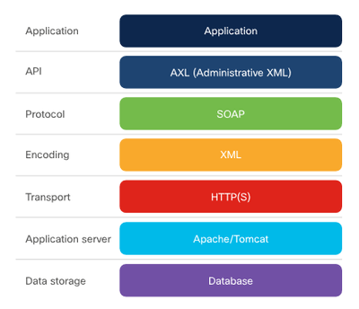
Cisco Collaboration Platforms Administrative XML Layer
Administrative XML Layer (AXL) is an XML/SOAP-based interface that provides a mechanism for inserting, retrieving, updating, and removing data from the Unified Communication configuration database.
Developers can use AXL and the provided Web Services Description Language (WSDL) to create, read, update, and delete objects such as gateways, users, devices, route-patterns and so on.
The AXL API is for administration and configuration.
AXL and the Unified Communication Configuration Database
Notes:
8 – Cisco Platforms and Development
8.6 - Cisco Collaboration Platforms
8.6.3 – Administrative XML Layer

Slide 105
Cisco Collaboration Platforms Administrative XML Layer (Contd.)
How it works?
AXL is a SOAP interface.
The methods for the objects begin with: list, add, update, get, and remove.
For example, listPhone lists all phones, and addUser creates a new user.
SQL queries
You can also perform direct SQL queries to update or retrieve data in the Unified CM configuration database using ExecuteSQLupdate or ExecuteSQLquery.
Versioning
The AXL schema version is backwards-compatible for up to two major releases.
This means developers can use AXL schema version 10.0(1) for Unified CM release 10.0(1) through 12.5(1).
Notes:
8 – Cisco Platforms and Development
8.6 - Cisco Collaboration Platforms
8.6.3 – Administrative XML Layer

Slide 106
Cisco Collaboration Platforms Administrative XML Layer (Contd.)
Advanced features
One of the most advanced feature of AXL is the Change Notification Feature.
You can use this SOAP request repeatedly to see what changes have been made to the system since the last time you ran the request.
You can request to see changes about specific categories, like Phone or User, or just see all changes.
Related SOAP-based Administration APIs
UC Manager Serviceability includes similar SOAP-based API requests for retrieving information about phones such as the registration status, the IP address, and so on.
It also includes a performance monitoring API, and an API to manage and get the status of CUCM services.
Notes:
8 – Cisco Platforms and Development
8.6 - Cisco Collaboration Platforms
8.6.3 – Administrative XML Layer

Slide 107
Cisco Collaboration Platforms User Data Services
What are User Data Services?
User Data Services (UDS) is a REST-based API that provides a mechanism for inserting, retrieving, updating and removing data from the Unified Communication configuration database.
Purpose
The UDS API is designed for end users to configure settings.
What you can do with UDS
UDS API can be used to create a directory search or manage user preferences and settings in the web application.
How it works
UDS is a REST-based interface that sends and receives XML-formatted data.
UDS implements the four common HTTP request methods: GET, POST, PUT, and DELETE.
Notes:
8 – Cisco Platforms and Development
8.6 - Cisco Collaboration Platforms
8.6.4 – User Data Services

Slide 108
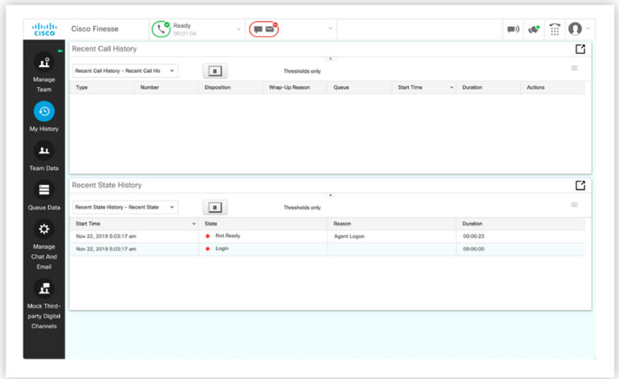
Cisco Collaboration Platforms Cisco Finesse
Finesse is Cisco's browser-based contact center agent and supervisor desktop.
Finesse has REST APIs and JavaScript APIs that can be used to:
Build custom agent desktops,
Integrate contact center functionality into applications
Integrate applications into the Finesse agent and supervisor desktop.
Finesse Agent and Supervisor Desktop
Notes:
8 – Cisco Platforms and Development
8.6 - Cisco Collaboration Platforms
8.6.5 – Cisco Finesse

Slide 109

Cisco Collaboration Platforms Cisco Finesse (Contd.)
What is a Contact Center?
A contact center, also known as a call center, is typically a centralized location where a company handles the customer service for their business. A Customer service can be provided in the form of calls, text, email, and chat.
Contact centers have been categorized into two tasks:
Inbound tasks: When customers initiate communication with customer service.
Outbound tasks: A customer interaction made from the contact center agent to a customer.
Customer Calling Customer Service Rep
Notes:
8 – Cisco Platforms and Development
8.6 - Cisco Collaboration Platforms
8.6.5 – Cisco Finesse

Slide 110
Cisco Collaboration Platforms Cisco Finesse (Contd.)
Contact center systems
Contact center systems are very complex.
Contact center systems perform skill-based routing using an Automatic Call Distributor (ACD)
Contact center systems also provide agent and supervisor management.
Finesse deployments
Finesse has two different deployments:
Standalone Finesse used with a Contact Center Enterprise system
Co-resident Finesse used with a Unified Contact Center Express.
Finesse communicates with the contact center system via the CTI protocol.
Notes:
8 – Cisco Platforms and Development
8.6 - Cisco Collaboration Platforms
8.6.5 – Cisco Finesse

Slide 111
Cisco Collaboration Platforms Cisco Finesse (Contd.)
Finesse APIs
It provides an extensive list of REST and JavaScript APIs for developers to integrate Finesse's functionality into applications or applications to be integrated into the Finesse agent desktop.
Finesse REST APIs
Finesse provides REST APIs for performing agent and supervisor actions programmatically.
Because the APIs are HTTP-based, they can be used in both thick and thin applications.
The Finesse REST APIs that use the GET verb are synchronous, whereas the remaining are asynchronous.
Notes:
8 – Cisco Platforms and Development
8.6 - Cisco Collaboration Platforms
8.6.5 – Cisco Finesse

Slide 112
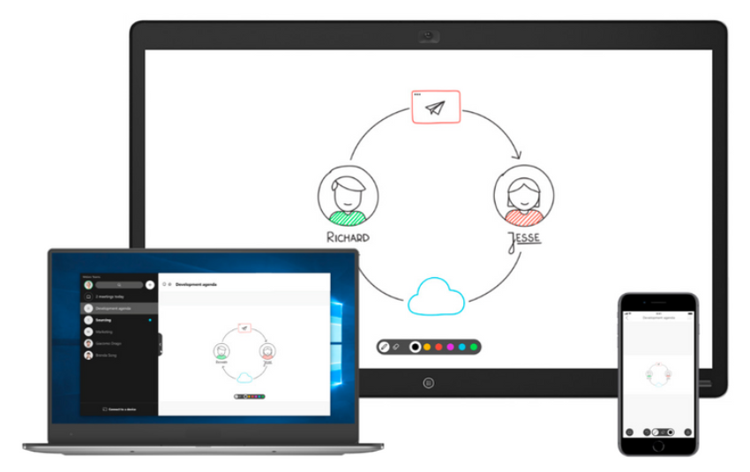
Cisco Collaboration Platforms Webex Teams
What is Webex Teams?
Cisco Webex Teams is an online collaboration solution to connect people and teams through chat, voice, and video.
With the Webex Teams app, you gain access to secure virtual work spaces.
Teams also integrates with Cisco Webex devices.
Features of Webex Teams
Create spaces
Create meetings
Work inside and outside the company the same way
Place calls
Webex Teams Clients
Notes:
8 – Cisco Platforms and Development
8.6 - Cisco Collaboration Platforms
8.6.6 – Webex Teams

Slide 113
Cisco Collaboration Platforms Webex Teams (Contd.)
Security
Users and sensitive information is kept safe with extensive controls to help you configure and control your security policies.
Integrations
Webex Teams includes pre-built solutions with third-party applications from vendors such as Microsoft, Google Cloud, and Salesforce.
Features of the Webex Teams API
The Webex Teams API is an extensive set of APIs that allow you to interact with the entire Webex Teams platform.
The capabilities include managing organizations, teams, people, rooms, memberships, and messages to creating conversational bots or embedded video calls
Notes:
8 – Cisco Platforms and Development
8.6 - Cisco Collaboration Platforms
8.6.6 – Webex Teams

Slide 114
Cisco Collaboration Platforms Webex Teams (Contd.)
Features of Webex Teams API | Description
Organizations | Represent a set of people in Webex Teams. Organizations may manage other organizations or be managed themselves.
Teams | Groups of people with a set of rooms visible to all members of that team. Teams API resources are teams to be managed, created, updated, and deleted.
People | Registered users of Webex Teams.
Rooms | Virtual meeting places where people post messages and collaborate to get work done. The Rooms API can manage, create, update, and delete rooms.
Memberships | Represent a person's relationship to a room. The Memberships API resources allow to list members of any room , create or revoke memberships, and update memberships to make someone a moderator of a room.
Team Memberships | Represent a person's relationship with a team.
Messages | Way of communication in a room. Use this API to list, create, and delete messages.
Notes:
8 – Cisco Platforms and Development
8.6 - Cisco Collaboration Platforms
8.6.6 – Webex Teams

Slide 115
Cisco Collaboration Platforms Lab – Construct a Python Script to Manage Webex Teams
In this lab, you will complete the following objectives:
Part 1: Launch the DEVASC VM
Part 2: Get Your Webex Teams Access Token
Part 3: Test Your Access Token
Part 4: Manage People in Webex Teams
Part 5: Manage Rooms in Webex Teams
Part 6: Manage Memberships in Webex Teams
Part 7: Manage Messages in Webex Teams
Notes:
8 – Cisco Platforms and Development
8.6 - Cisco Collaboration Platforms
8.6.7 – Lab – Construct a Python Script to Manage Webex Teams

Slide 116
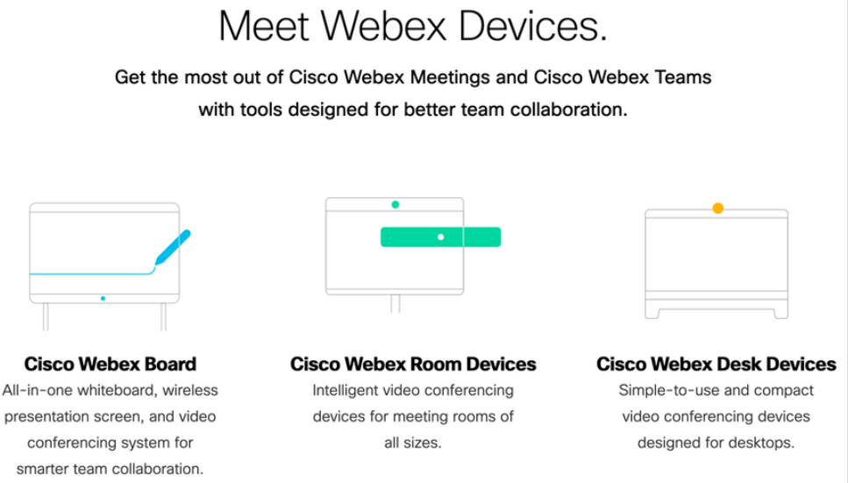
Cisco Collaboration Platforms Webex Devices
Cisco Webex Devices provide access to all Webex's features.
Webex Boards, Room Devices, and Desk Devices enable collaboration through video, calling, and programmability.
Types of Webex Devices
Notes:
8 – Cisco Platforms and Development
8.6 - Cisco Collaboration Platforms
8.6.8 – Webex Devices

Slide 117



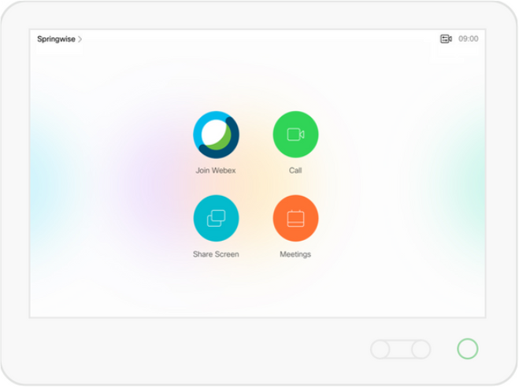
Cisco Collaboration Platforms Webex Devices (Contd.)
Webex Board Series
All-in-one team collaboration devices for meeting rooms and spaces.
Webex Room Series
Brings integrated video conferencing systems to every room.
Webex Desk Series
Brings high-quality video conferencing to your desktop.
Cisco Touch 10
Intuitive touchscreen device for interacting with Cisco conferencing systems.
Webex Board Series Webex Room Series
Webex Desk Series Cisco Touch 10
Notes:
8 – Cisco Platforms and Development
8.6 - Cisco Collaboration Platforms
8.6.8 – Webex Devices

Slide 118
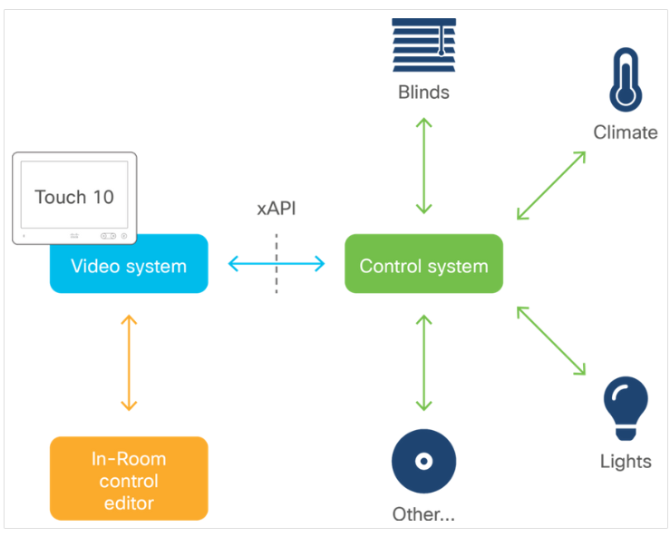
Cisco Collaboration Platforms Webex Devices (Contd.)
Programmability for Cisco Collaboration Devices:
Webex Devices can be customized through the API, known as the xAPI. This enables bi-directional communication with third-party applications and control systems.
There are multiple ways to access xAPI including Telnet/SSH, HTTP, and RS-232 serial connection.
xAPI supports both XML and JSON and JavaScript Macros for on-device customization
Customization Examples
Notes:
8 – Cisco Platforms and Development
8.6 - Cisco Collaboration Platforms
8.6.8 – Webex Devices

Slide 119
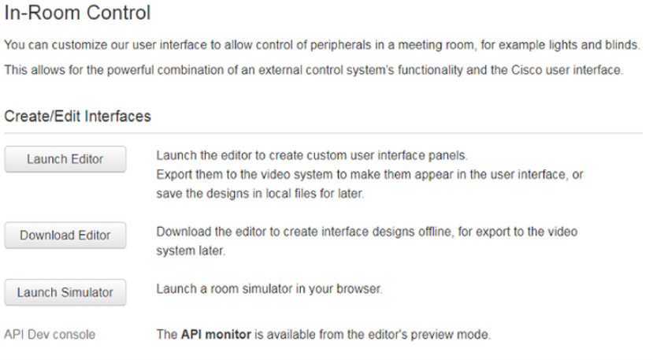
Cisco Collaboration Platforms Webex Devices (Contd.)
UI Extensions (In-Room Controls) and macros
UI Extensions describe custom widgets, buttons, and other virtual controllers that you can create and deploy. These used to be globally, referred to as "In-Room Controls".
Going forward there is only one tool UI Extensions Editor and In-Room Controls will be a subset of UI Extensions.
Notes:
8 – Cisco Platforms and Development
8.6 - Cisco Collaboration Platforms
8.6.8 – Webex Devices

Slide 120

Cisco Collaboration Platforms Webex Devices (Contd.)
What UI Extensions do
UI Extensions enable you to add custom user interface elements to the Touch 10 display.
Launching the simulator from “UI Extensions Editor” will load a virtual meeting room, equipped with several automated systems controlled from switches on the walls.
The switch controls let you switch the projector on or off, interact with the projector canvas, close/open the blinds, and so on.
Notes:
8 – Cisco Platforms and Development
8.6 - Cisco Collaboration Platforms
8.6.8 – Webex Devices

Slide 121
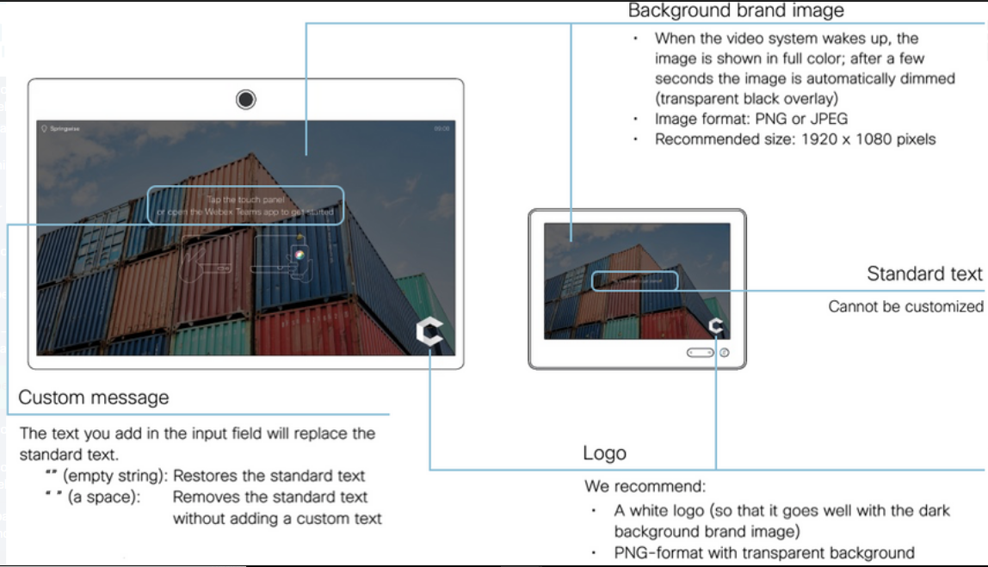
Cisco Collaboration Platforms Webex Devices (Contd.)
Personalizing Collaboration Devices
As of version 9.2 of Cisco's Collaboration Endpoint software release, on-screen branding, signage and message customization options let you personalize the appearance of a room device and its Touch10 interface.
Branding and customization of the room device "Halfwake" screen lets you:
Add a background image
Add a small logo image to the bottom right corner
Customize or remove the default on-screen welcome message
Touch 10 Personalization in ‘Halfwake’ state
Notes:
8 – Cisco Platforms and Development
8.6 - Cisco Collaboration Platforms
8.6.8 – Webex Devices

Slide 122

Cisco Collaboration Platforms Webex Devices (Contd.)
In the ‘Awake’ state, you can:
Add a small logo image to the bottom right corner (screen/Touch10)
Add a label or message to the bottom left corner (screen only)
Touch 10 Personalization in Awake State
Notes:
8 – Cisco Platforms and Development
8.6 - Cisco Collaboration Platforms
8.6.8 – Webex Devices

Slide 123
8.7 Cisco Security Platforms
Notes:
Source:
8 – Cisco Platforms and Development
8.7 - Cisco Security Platforms
In-Session Activities / Explanations:
Time: 30 mins
Instructor Notes:
Provide a brief introduction on Cisco Security Platforms
Describe each security platform including the architecture, integration, environment, capabilities and APIs.
Key Points: Advanced Malware Protection (AMP) for Endpoints, Cisco Firepower Management Center (FMC), Cisco Firepower Threat Defense (FTD), Cisco Identity Services Engine (ISE), Cisco Threat Grid, Cisco Umbrella

Slide 124
Cisco Security Platforms Introduction
To secure a network or an application, you need automated ways to identify threats and mitigate risks, as well as ways to configure systems with security in mind.
Scripts can ingest data faster than a human.
Cisco provides a large portfolio of security technologies and product families which are configurable and manageable via APIs. These mainly include:
Advanced Malware Protection (AMP) for Endpoints
Cisco Firepower Management Center (FMC)
Cisco Firepower Threat Defense (FTD)
Cisco Identity Services Engine (ISE)
Cisco Threat Grid
Cisco Umbrella
Notes:
8 – Cisco Platforms and Development
8.7 - Cisco Security Platforms
8.7.1 - Introduction

Slide 125
Cisco Security Platforms Cisco Advanced Malware Protection (AMP)
What is AMP?
Cisco Advanced Malware Protection (AMP) for Endpoints provides API access to automate security workflows and includes advanced sandboxing capabilities to inspect any file that looks like malware in a safe and isolated way.
Architecture
AMP has a collection of subscription-based products that are managed with a centralized web-based console. You can deploy AMP on mobile phones and email or web servers.
Integrations
AMP integrates across the Cisco security portfolio with deployment options such as Cisco Umbrella and Meraki MX.
Environment and scale
AMP for Endpoints can be used in a university campus setting, within healthcare organizations, for government entities, or industrial and manufacturing environments.
Notes:
8 – Cisco Platforms and Development
8.7 - Cisco Security Platforms
8.7.2 - Cisco Advanced Malware Protection (AMP)

Slide 126

Cisco Security Platforms Cisco Advanced Malware Protection (AMP) (Contd.)
Capabilities
There are three main categories of capabilities that AMP offers:
Prevention: AMP protects against identified threats in malware files by preventing breaches.
Detection: AMP continuously monitors and records all file activity to detect malware.
Responses and automation: AMP accelerates investigations and automatically remediates malware across PCs, Macs, Linux, servers, and mobile devices (Android and iOS).
Cisco AMP Detection
Notes:
8 – Cisco Platforms and Development
8.7 - Cisco Security Platforms
8.7.2 - Cisco Advanced Malware Protection (AMP)

Slide 127

Cisco Security Platforms Cisco Firepower Products
Firepower Management Center (FMC) is a central management console that can configure all aspects of Firepower Threat Defense (FTD) including access control rules and policy object configuration.
With FMC, devices on the network can be managed for controlling and filtering the network traffic based on various characteristics.
The FMC API and FTD APIs cannot directly co-exist and hence you have to choose either:
Firepower Device Manager (FDM)/FTD-API/CDO or FMC
FMC and FTD
Notes:
8 – Cisco Platforms and Development
8.7 - Cisco Security Platforms
8.7.3 - Cisco Firepower Products

Slide 128
Cisco Security Platforms Cisco Firepower Products (Contd.)
Protection
Firepower Threat Defense configuration with Firepower Device Manager also provides protective services that are listed here:
Track, backup, and protect CA Certificates.
Manage, backup, encrypt, and protect private keys.
Internet Key Exchange (IKE) key management.
Provide Access Control Lists to select traffic for services. Two types of ACL can be configured: Extended and Standard
Architecture
FMC can run on VMware vSphere or Amazon Web Services (AWS) and also on a range of physical devices like Cisco FMC 1000, 1600, 2000, 2500, 2600, 4000, 4500, and 4600.
Firepower management tools are purpose-built for customers to manage and configure their Firepower Threat Defense devices. These tools include FMC and FDM.
Notes:
8 – Cisco Platforms and Development
8.7 - Cisco Security Platforms
8.7.3 - Cisco Firepower Products

Slide 129
Cisco Security Platforms Cisco Firepower Products (Contd.)
Integrations
Firepower Management Center (and Device Manager, though currently with a limited feature set) can integrate with Cisco Identity Services Engine (ISE).
The integration of ISE with FMC enables movement of particular users in or out of quarantine after they start a VPN session.
Other products, such as Threat Grid and Umbrella, can integrate with Firepower Threat Defense devices.
Environment and scale
Within FTD, FDM and Next Generation Firewall APIs help small and medium-sized businesses so that they do not have to hire security experts.
API authentication
For the FMC API, you use an access token to authenticate to the REST API. The token lasts for 30 minutes before the client must refresh it.
To make the call, you use the header X-auth-access-token:<authentication token value>.
Notes:
8 – Cisco Platforms and Development
8.7 - Cisco Security Platforms
8.7.3 - Cisco Firepower Products

Slide 130

Cisco Security Platforms Cisco Identity Services Engine (ISE)
What is ISE?
The Cisco Identity Services Engine (ISE) is an integral part of the Cisco security portfolio.
ISE provides a rule-based engine for enabling policy-based network access to users and devices.
Architecture
Cisco ISE architecture consists of nodes with defined node types: Administration, Policy Service, Monitoring, or pxGrid.
The remaining pieces of the architecture include network resources and endpoints, or devices connecting to the network.
Cisco ISE Overview
Notes:
8 – Cisco Platforms and Development
8.7 - Cisco Security Platforms
8.7.4 - Cisco Identity Services Engine (ISE)

Slide 131
Cisco Security Platforms Cisco Identity Services Engine (ISE) (Contd.)
Integrations
Cisco ISE integrates with identity systems for identity management including role-based access control (RBAC), Okta/SAML Single-Sign On (SSO), Lightweight Directory Access Protocol (LDAP), Active Directory (AD).
Capabilities and use cases
ISE's capabilities can be summarized as follows:
Asset visibility
Policy compliance
Secure wired access
Segmentation
Notes:
8 – Cisco Platforms and Development
8.7 - Cisco Security Platforms
8.7.4 - Cisco Identity Services Engine (ISE)

Slide 132

Cisco Security Platforms Cisco Threat Grid
What is Cisco Threat Grid?
Threat Grid is a malware analysis platform that combines static and dynamic malware analysis with threat intelligence from global sources.
Benefits and Purpose
Review and analyze potential threats or behavior indicators of malware activity.
The user interface and API workflows are designed for Security Operations Center (SOC) analysts, malware analysts, security specialists, and forensic investigators.
Cisco Threat Grid Overview
Notes:
8 – Cisco Platforms and Development
8.7 - Cisco Security Platforms
8.7.5 - Cisco Threat Grid

Slide 133
Cisco Security Platforms Cisco Threat Grid (Contd.)
Integrations
Threat Grid is also available through integrations with other Cisco Security products, such as Advanced Malware Protection, next-generation firewalls, and Cisco ASA with FirePOWER Services.
Environment and scale
The content subscription license has the capacity to sample and analyze between 500 and 10,000 samples per day.
Capabilities
Threat Grid offers malware analysis capabilities:
Static analysis - provides identifying information about the file, file headers, and its contents.
Dynamic analysis - executes the malware in a safe, specialized virtual environment called a "glovebox".
Notes:
8 – Cisco Platforms and Development
8.7 - Cisco Security Platforms
8.7.5 - Cisco Threat Grid

Slide 134

Cisco Security Platforms Cisco Umbrella
What is Cisco Umbrella?
Umbrella uses Domain Name Servers (DNS) to enforce security on the network.
Umbrella blocks access to malicious domains, URLs, IPs, and files.
Architecture
APIs and data-driven architecture provide the base of the Umbrella service. There are a few APIs to use with Cisco Umbrella:
Enforcement API
Network Devices API
Investigate API
Reporting API
Cisco Umbrella Overview
Notes:
8 – Cisco Platforms and Development
8.7 - Cisco Security Platforms
8.7.6 - Cisco Umbrella

Slide 135
Cisco Security Platforms Cisco Umbrella (Contd.)
Integrations
You can integrate Meraki MR and Umbrella for wireless protection use cases.
Use the Umbrella Enforcement API to take actions on a domain request, or use the Umbrella Investigate API to pull threat intelligence data programmatically.
Environment and scale
Umbrella is used in larger retailers, large hospital settings, and university campuses. It can protect hundreds, thousands, or tens of thousands of endpoints.
Capabilities
Umbrella's protection capabilities include:
Wi-Fi protection when guests are on your network
Selected application blocking
Endpoint security for off-network (not on VPN) devices
Web filtering
Notes:
8 – Cisco Platforms and Development
8.7 - Cisco Security Platforms
8.7.6 - Cisco Umbrella

Slide 136
8.8 Cisco Platforms and Development Summary
Notes:
Source:
8 – Cisco Platforms and Development
8.8 – Cisco Platforms and Development Summary
In-Session Activities / Explanations:
Time: 5 mins
Instructor Notes:
Read out the summary points mentioned on the slide.
Discuss the same with the participants.
Ask if they have any questions or doubts.
Assist the learners to perform the Packet tracers.
At the end, ensure the learners take the module quiz.
Key Points: NA

Slide 137
Cisco Platforms and Development Summary What Did I Learn in this Module?
To sort the Cisco developer offerings, DevNet creates Dev Centers for each technology group.
Cisco Dev Centers include: Unified Communications Manager, Cloud, Collaboration, Data center, Internet of Things(IoT) and edge computing, Networking, Security, Wireless and mobile, and Application developers.
Software Development Kit (SDK) contains a set of software development tools integrated for developing applications for a specific device or system.
Model-driven programmability inherits the power of models. There are two types of YANG models, open and native.
Network Configuration (NETCONF) is a protocol designed to install, manipulate, and delete the configuration of network devices.
Network automation is used for various common tasks in an organization.
Notes:
8 – Cisco Platforms and Development
8.8 – Cisco Platforms and Development Summary
8.8.1 – What did I learn in this Module?

Slide 138
Cisco Platforms and Development Summary What Did I Learn in this Module? (Contd.)
Internetwork Operating System (IOS) was original operating system and IOS-XE is the next-generation programmable platform.
Cisco DNA Center is a foundational controller and analytics platform for large and midsize organizations providing a single dashboard for network management, network automation, network assurance, monitoring, analytics, and security.
The Cisco Unified Computing System (UCS), along with its software and SaaS adjuncts, provides a complete physical and logical plant for compute, networking, and storage in the modern datacenter.
Cisco Intersight is a Software as a Service (SaaS) systems management platform capable of managing infrastructure at the edge and remote locations as well as in the data center.
Cisco's suite of on-premise and cloud-based collaboration solutions includes Unified Communications Manager, Contact Center, Finesse, and Webex. Cisco Unified Communications Manager is also known as Unified CM, CUCM or CallManager.
Notes:
8 – Cisco Platforms and Development
8.8 – Cisco Platforms and Development Summary
8.8.1 – What did I learn in this Module?

Slide 139
Cisco Platforms and Development Summary What Did I Learn in this Module? (Contd.)
AXL is an XML/SOAP-based interface that provides a mechanism for inserting, retrieving, updating, and removing data from the Unified Communication configuration database.
UDS is a REST-based API that provides a mechanism for inserting, retrieving, updating and removing data from the Unified Communication configuration database.
Finesse is Cisco's browser-based contact center agent and supervisor desktop.
Cisco Webex Teams is an online collaboration solution to connect people and teams through chat, voice, and video.
Cisco provides a large portfolio of security technologies and product families which are configurable and manageable via APIs.
Notes:
8 – Cisco Platforms and Development
8.8 – Cisco Platforms and Development Summary
8.8.1 – What did I learn in this Module?

Slide 140
Cisco Platforms and Development Summary Packet Tracer - Compare using CLI and an SDN Controller to Manage a Network
In this Packet Tracer activity, you will compare the differences between managing a network from the command line interface (CLI) and using a software-defined networking (SDN) controller to manage the network.
You will complete these objectives:
Part 1: Explore the Network Topology
Part 2: Use the CLI to Gather Information
Part 3: Configure an SDN Controller
Part 4: Use an SDN Controller to Discover a Topology
Part 5: Use an SDN Controller to Gather Information
Part 6: Use an SDN Controller to Configure Network Settings
Notes:
8 – Cisco Platforms and Development
8.8 – Cisco Platforms and Development Summary
8.8.2 – Packet Tracer - Compare using CLI and an SDN Controller to Manage a Network

Slide 141
Cisco Platforms and Development Summary Packet Tracer - Implement REST APIs with an SDN Controller
In this Packet Tracer activity, you will use the Packet Tracer Network Controller and associated API documentation to send REST requests from Postman and from Visual Studio Code (VS Code).
You will complete these objectives:
Part 1: Launch the DEVASC VM
Part 2: Verify External Connectivity to Packet Tracer
Part 3: Request an Authentication Token with Postman
Part 4: Send REST Requests with Postman
Part 5: Send REST Requests with VS Code
Part 6: Send REST Requests Inside Packet Tracer
Notes:
8 – Cisco Platforms and Development
8.8 – Cisco Platforms and Development Summary
8.8.3 – Packet Tracer - Implement REST APIs with an SDN Controller
8.8.4 -- Module 8: Cisco Platforms and Development Quiz

Slide 142
Module 8 New Terms and Commands
Software-Defined Networking (SDN) Cisco Unified Communications Manager (CUCM) Open Web Applications Security Project (OWASP) Software Development Kit (SDK) Yet Another Next Generation (YANG) Operational Expenses (OPEX) Cisco ACI Cobra Cisco Meraki Cisco Nexus Operating System (NX-OS) Cisco Integrated Management Controller (CIMC) | Cisco IOS XE Cisco DNA Center Role-Based Access Control (RBAC) Cisco Enterprise NFV Infrastructure Software (NFVIS) Cisco Application Centric Infrastructure (ACI) Application Policy Infrastructure Controller (APIC) Cisco Software-Defined - Wide Area Networking (SD-WAN) vManage Unified Computing System (UCS) Virtual IP address (VIP) | APIC REST Python adapter (ARYA) Bluetooth Low Energy (BLE) MQTT-based protocols Open Shortest Path First (OSPF) Configuration Database (CDB) FASTMAP Management Agent API (MAAPI) Cisco Network Services Orchestrator (NSO) ACID (Atomic, Consistent DB, Isolated, and Durable) Cisco UCS Central (UCSC) Cisco UCS Manager (UCSM)
Notes:
8 – Cisco Platforms and Development
New Terms and Commands

Slide 143
Module 8 New Terms and Commands (Contd.)
Software as a Service (SaaS) Cisco Unified Communications Manager (Unified CM) JavaScript Object Notation (JSON) Platform Administrative Web Services (PAWS) Java Telephony API (JTAPI) Telephony API (TAPI) Client Matter Codes (CMC) Cisco Unity Connection (CUC) Finesse Administrative XML Layer (AXL) CloupiaScript Cisco Intersight | Web Services Description Language (WSDL) User Data Services (UDS) Contact Center Enterprise (CCE) Unified Contact Center Enterprise (UCCE) Packaged Contact Center Enterprise (PCCE) Automatic Call Distributor (ACD) Webex Teams Cisco Touch 10 Halfwake state Awake state Cisco Advanced Malware Protection (AMP) Cisco UCS Director | Cisco Firepower Management Center (FMC) Firepower Threat Defense (FTD) Cisco Identity Services Engine (ISE) Cisco Threat Grid Cisco Umbrella Management Information Model (MIM) fabricVlan Finite State Machine processes (FSMs) UCS PowerTool PowerShell Cmdlets Logical Unit Numbers (LUNs)
Notes:
8 – Cisco Platforms and Development
New Terms and Commands

